Slide 1
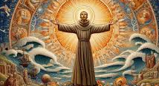
St Francis of Assisi
Canticle of The Creatures
(Canticle of The Sun, Laudes Creaturarum)
Staff Formation Session
Notes:
Welcome to our Professional Learning Session where we invite you all into a prayerful encounter with God through Creation, using the witness of St Francis of Assisi, Scripture, and the Canticle of Creation, and to begin forming a shared spiritual language that will later connect to Laudato Si’ and Catholic Social Teaching.

Slide 2

Notes:
Carmela

Slide 3
Purpose / Aim of Session
Cognitive Outcomes
By the end of the session participants will:
Explain the theological vision of creation expressed in Scripture, particularly the Psalms and The Canticle of the Creatures, and its influence on Catholic spirituality.
Identify key connections between the Canticle of Creation, Laudato Si’, Catholic Social Teaching, the Sacraments, and the mission of Catholic schools.
Analyse how an understanding of creation as gift and relationship shapes Christian responsibility, stewardship, and mission within school communities.
Affective Outcomes
By the end of the session participants will:
Develop a deeper sense of gratitude, reverence, and wonder for creation as an expression of God’s presence and love.
Value care for creation as a Gospel‑centred commitment that integrates faith, justice, and hope in their personal and professional practice.

Slide 4
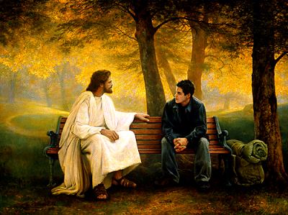
Encounter
Discipleship is a personal encounter with Jesus Christ that leads a person to engage more deeply with the life of faith and embark on a lifelong journey as a member of the Church. Thus, discipleship invites us to:
encounter Jesus, and to respond to this initial encounter by following him
engage with the kerygma, assimilating it into every aspect of life as we grow in knowledge and love of Jesus
embark on a life of mission as we discern the unique call of Jesus to share the Gospel, build the kingdom and convey the joy of the Good News to others.
Notes:
Full article: Discipleship: Encountering Jesus
Artwork by: Greg Olsen

Slide 5
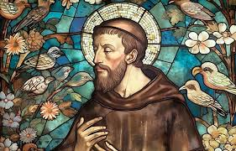
St Francis
Encounter
Who was he?
He was a model of Christian Discipleship.
He lived at a time of social upheaval and personal suffering.
He saw creation not as something to dominate, but as family: Brother Sun, Sister Moon, Mother Earth.
His fundamental value was radical poverty of spirit,
humility, and praise of God through all creation.
“Francis teaches us that the way we see creation
reveals the way we understand God.”
Notes:
We now begin our Encounter with God.
We invite everyone to place your feet on the floor, sit comfortably, and take a slow breath.
“We acknowledge God’s living presence in all of creation — in this space, in one another, and within ourselves.”
Briefly introduce St Francis as a model of Christian discipleship:
St Francis lived at a time of social upheaval and personal suffering.
He saw creation not as something to dominate, but as family — Brother Sun, Sister Moon, Mother Earth.
His fundamental value was radical poverty of spirit, humility, and praise of God through all creation.
“Francis teaches us that the way we see creation reveals the way we understand God.”

Slide 6
Psalms
Encounter
Psalm 148 (Excerpt) All Creation Called to Praise
Praise the Lord from the heavens; praise him in the heights.
Praise him, sun and moon; praise him, shining stars.
Praise him, mountains and hills, fruit trees and cedars, wild animals and all cattle, creeping things and flying birds.

Slide 7
Psalms
Encounter
Psalm 104 (Excerpt) God’s Delight in Sustaining Creation
O Lord, how manifold are your works!
In wisdom you have made them all; the earth is full of your creatures.
These all look to you to give them their food in due season.
When you open your hand, they are filled with good things.

Slide 8
Psalms
Encounter
Psalm 19:1–6 (Excerpt) Creation Proclaims God’s Glory
The heavens proclaim the glory of God;
the firmament shows forth the work of his hands.
Day to day pours forth speech,
and night to night declares knowledge.
There is no speech, nor are there words,
yet their voice goes out through all the earth.

Slide 9
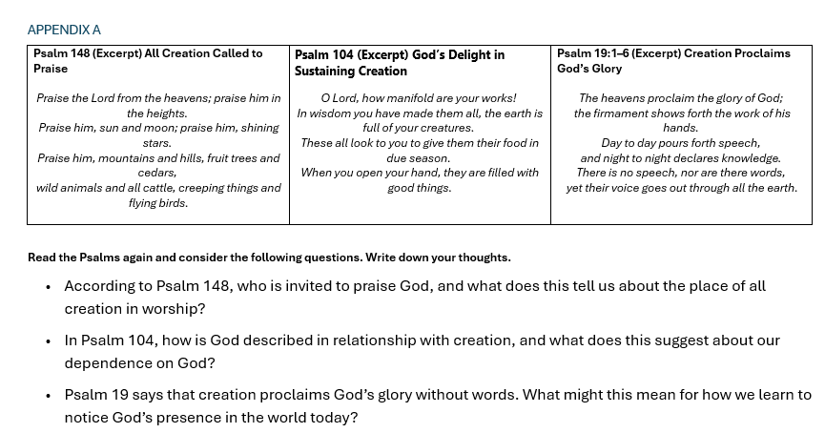
Check For Understanding
Encounter

Slide 10
Canticle Of The Creatures
The Canticle of The Creatures (also called The Canticle of Brother Sun) was written by St Francis near the end of his life, when he was:
Physically suffering
Experiencing blindness
Living in great vulnerability
The Canticle is a song of praise, not lament.
It echoes the themes of Psalm 148 and Psalm 19, all creation glorifying God simply by being itself.
Notes:
Facilitator: St Francis wrote The Canticle of the Creatures near the end of his life, during a time of great suffering. He was physically unwell, largely blind, and deeply vulnerable. Rather than focusing on pain or complaint, Francis chose to write a song of praise. Through the Canticle, he expressed deep gratitude to God for all of creation, recognising every element of the natural world as a brother or sister that reflects God’s goodness.
The Canticle reveals Francis’ unwavering faith and his belief that creation gives glory to God simply by being what it was created to be. Even in suffering, Francis saw beauty, relationship, and praise woven through the whole of creation — a vision that continues to inspire Christian spirituality and underpins the message of Laudato Si’.
On slide:
The Canticle of Creation (also called The Canticle of Brother Sun) was written by St Francis near the end of his life, when he was:
Physically suffering
Experiencing blindness
Living in great vulnerability
The Canticle is a song of praise, not lament.
It echoes the themes of Psalm 148 and Psalm 19 — all creation glorifying God simply by being itself.

Slide 11
Canticle Of The Creatures
“Why would someone choose praise, even in suffering?”

Slide 12
Canticle Of The Creatures
Written near the end of his life while ill and near death, The Canticle of the Creatures expresses St Francis’ deepest theological vision. In it, Francis presents all relationships, human and non-human, as rooted in family, naming creation as brother, sister, and mother. He recognises humanity’s mutual dependence with creation and affirms that all elements of the natural world give praise to God simply by being what they are. The Canticle reveals Francis’ profound sensitivity to the goodness of creation and points toward a new creation marked by reconciliation, peace, and eternal praise of God.
https://www.sbfranciscans.org/spirituality/the-canticle-of-the-creatures/

Slide 13
Links to Laudato Si
“Praise be to you, my Lord”. In the words of this beautiful canticle, Saint Francis of Assisi reminds us that our common home is like a sister with whom we share our life and a beautiful mother who opens her arms to embrace us.
“Praise be to you, my Lord, through our Sister, Mother Earth, who sustains and governs us, and who produces various fruit with coloured flowers and herbs”.[1]
https://www.vatican.va/content/francesco/en/encyclicals/documents/papa-francesco_20150524_enciclica-laudato-si.html

Slide 14
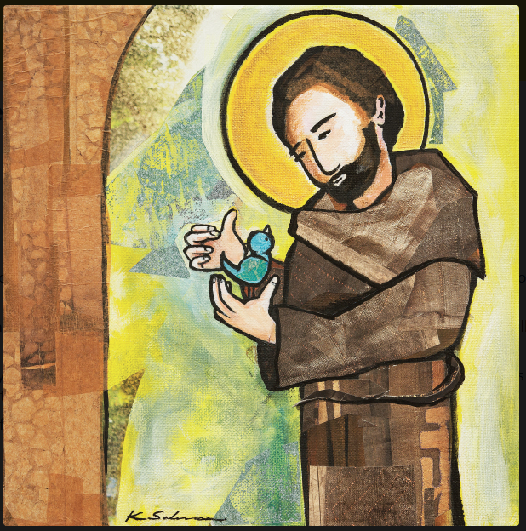
Links to Laudato Si
Laudato Si invites the Church to:
Recover a spirit of GRATITUDE
See care for creation as a GOSPEL ISSUE
Recognise the interconnectedness of CREATION, JUSTICE AND FAITH
“The Canticle of The Creatures IS The Heart and Soul of Laudato Si’”
Notes:
Facilitator: Before we move into our ENGAGE section, think about one word, image or phrase that has stood out to you that you will now carry forward as we engage with Laudato Si, the Psalms and the Catholic Social Teachings.

Slide 15

Engage
Discipleship is a personal encounter with Jesus Christ that leads a person to engage more deeply with the life of faith and embark on a lifelong journey as a member of the Church. Thus, discipleship invites us to:
encounter Jesus, and to respond to this initial encounter by following him
engage with the kerygma, assimilating it into every aspect of life as we grow in knowledge and love of Jesus
embark on a life of mission as we discern the unique call of Jesus to share the Gospel, build the kingdom and convey the joy of the Good News to others.

Slide 16
Engage
Care of the earth, care for the people and care for the future cannot be separated…

Slide 17

Engage
Create a poster/image with the matching quotes from the different documents using the canticle pathways.

Slide 18
Towards Deeper Thinking
What is this part of the canticle along with the links made, asking of us as staff in a Catholic school particularly as we enter the season of creation?
Inspired by the Canticle of the Earth, I commit to living with gratitude for the world entrusted to us…
I commit to fostering hope and responsibility by linking care for the earth with faith, justice, and love…
Engage

Slide 19
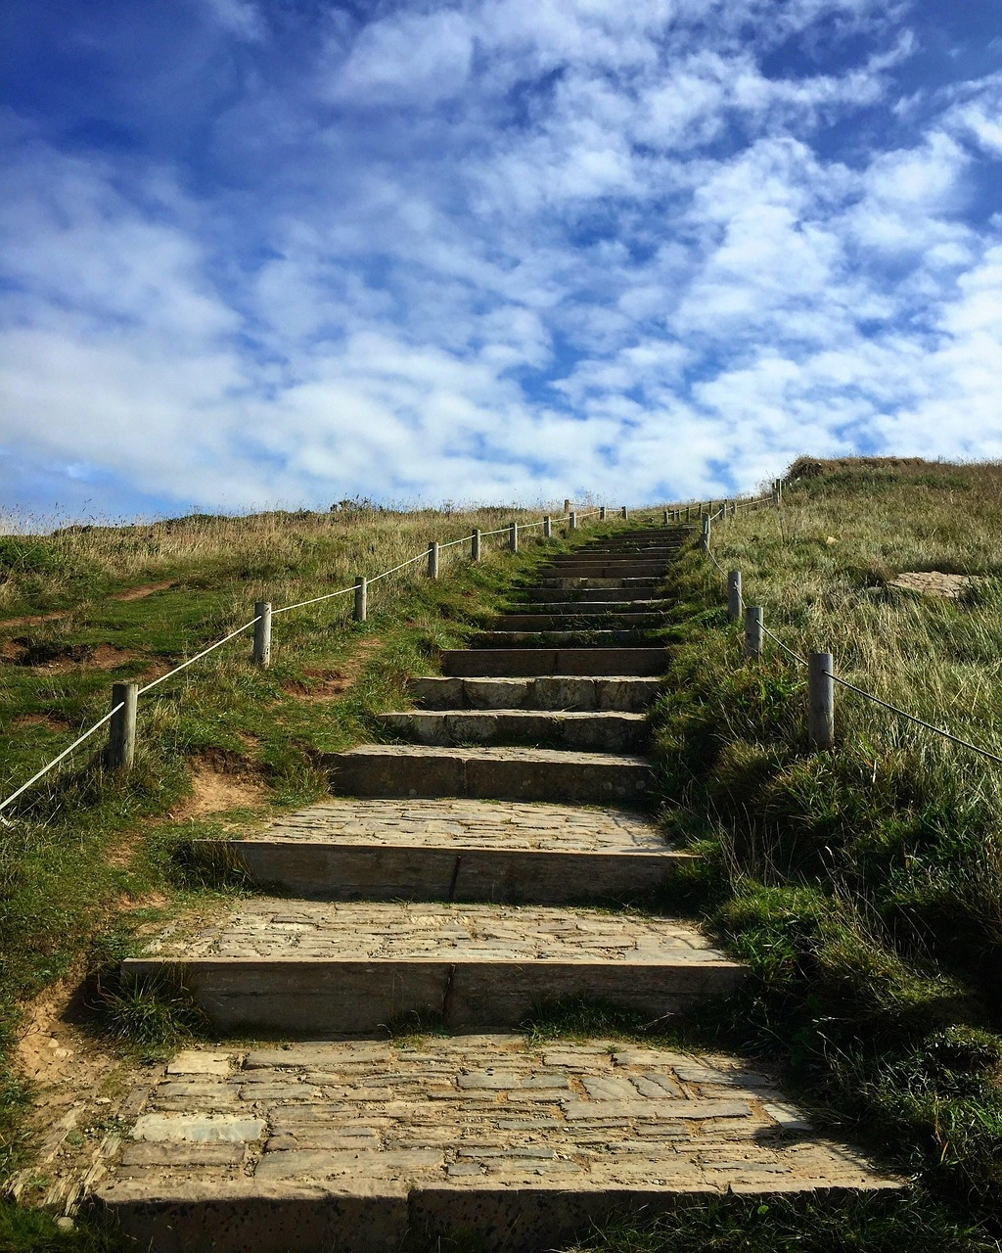
Embark
Discipleship is a personal encounter with Jesus Christ that leads a person to engage more deeply with the life of faith and embark on a lifelong journey as a member of the Church. Thus, discipleship invites us to:
encounter Jesus, and to respond to this initial encounter by following him
engage with the kerygma, assimilating it into every aspect of life as we grow in knowledge and love of Jesus
embark on a life of mission as we discern the unique call of Jesus to share the Gospel, build the kingdom and convey the joy of the Good News to others.

Slide 20
Catechesis and Evangelisation
From Praise to Practice
Embark
The Canticle of Creation reminds us that faith begins in praise, but it does not end there.
As we reflect on the Canticle of creation, sacrament, justice, and mission, we are invited to consider how our beliefs are lived each day in our school communities.

Slide 21

Catechesis and Evangelisation
Naming Our Pledge
Return to the shared poster and add a simple pledge. Name one small step you will take this term to express care for creation, uphold human dignity, restore relationships, or contribute to a just and hope filled school community.

Slide 22
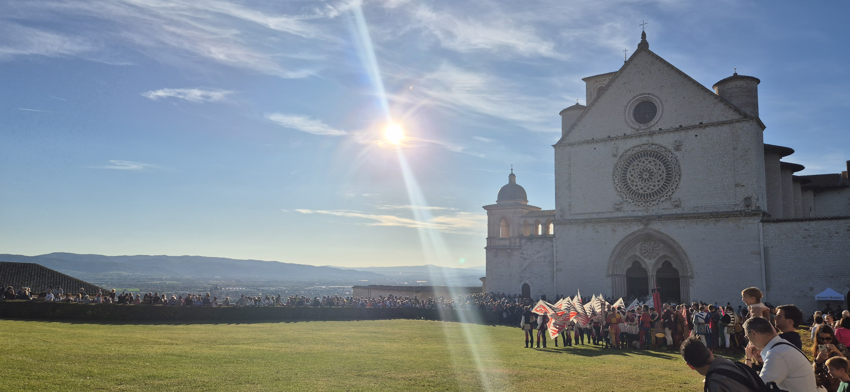
Closing Prayer
Let us pray together
In the name of the Father, and of the Son, and of the Holy Spirit.
Praise be to you, loving God,
for Brother Sun who brings us light and hope,
for Sister Moon and the stars who watch over us in the night,
for Brother Wind and Sister Water,
for Brother Fire and Sister Mother Earth,
who sustain us and gift us life.
Like St Francis, may we learn to see all creation as family,
to recognise your living presence in the world around us,
and to respond with gratitude, humility, and care.
Send us forth renewed in spirit,
to live gently upon the earth,
to act justly toward all people,
and to praise you in all that we do.
We make this prayer through Christ our Lord.
Amen.

