Slide 1

Called Beyond the Road: Mission, Vocation & New Maps of Hope
Staff Formation Session

Slide 2
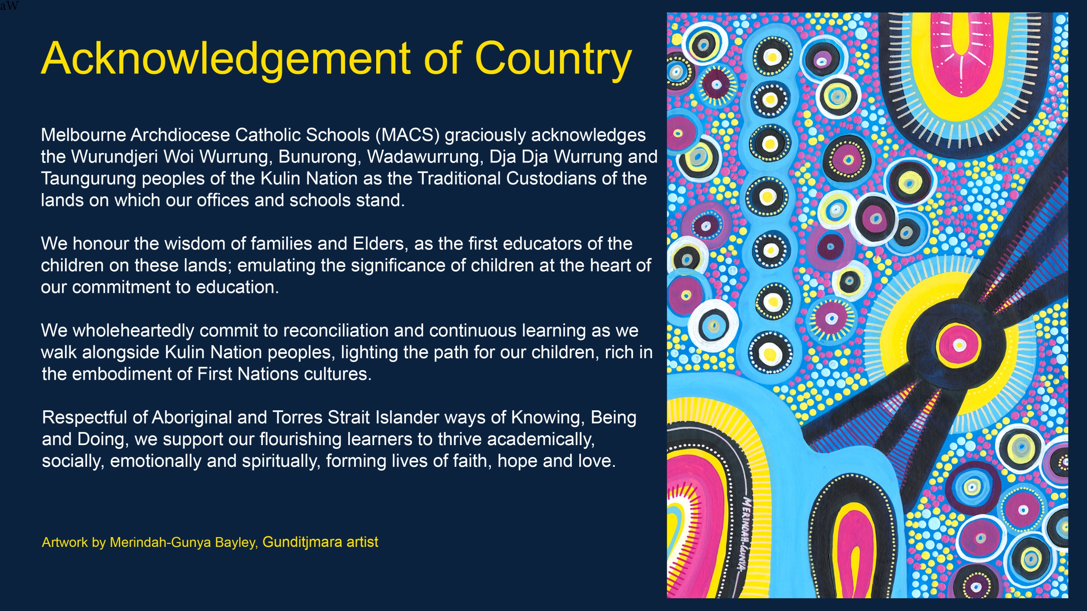
Notes:
Carmela

Slide 3
Purpose / Aim of Session
Cognitive Outcomes
By the end of the session participants will:
Explain the Catholic understanding of mission and vocation, distinguishing them from career or profession,
Identify and summarise the core themes of the apostolic letter ‘Drawing Maps of Hope”, including education as evangelisation, accompaniment, bridge‑building, and the call to form the whole person.
Analyse the Emmaus narrative and apply its movements (walking with, listening deeply, hearts burning, being sent forth) to their own school context and daily practice.
Affective Outcomes
By the end of the session participants will:
1. Develop a deeper appreciation for their own call to serve, recognising their work as meaningful, God given, and connected to a shared communal purpose.
2. Value their identity as educators within the Church’s mission, feeling inspired by the document’s vision of hope, creativity, and renewal in today’s educational landscape.

Slide 4
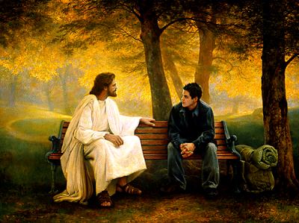
Encounter
Discipleship is a personal encounter with Jesus Christ that leads a person to engage more deeply with the life of faith and embark on a lifelong journey as a member of the Church. Thus, discipleship invites us to:
encounter Jesus, and to respond to this initial encounter by following him
engage with the kerygma, assimilating it into every aspect of life as we grow in knowledge and love of Jesus
embark on a life of mission as we discern the unique call of Jesus to share the Gospel, build the kingdom and convey the joy of the Good News to others.
Notes:
Full article: Discipleship: Encountering Jesus
Artwork by: Greg Olsen

Slide 5
The Heart of Catholic Education
Encounter
We are people of mission and vocation, called into a story larger than ourselves. We are a people of mission in our “everyday gestures, even when we are frail, distracted , poor and battered.” (Missio, 2023)
Section 5 of the papal document ‘DECREE AD GENTES ON THE MISSION ACTIVITY OF THE CHURCH’ states:
The Church’s mission is to share Christ with everyone. Guided by the Holy Spirit, she does this by her example, her preaching, and the sacraments, leading people toward Christ’s faith, freedom, and peace so they can fully share in his life. Vatican Council II, Ad Gentes (1965).

Slide 6
The Heart of Catholic Education
Encounter
We are people of mission and vocation, called into a story larger than ourselves. We are a people of mission in our “everyday gestures, even when we are frail, distracted , poor and battered.” (Missio, 2023)
Vocation is the very things that we are each called to do, specifically that God has called us to do. (Melbourne Catholic, n.d.)
Our vocation isn’t about our profession or career path. Rather it refers to the very specific way God is calling us to love others.

Slide 7
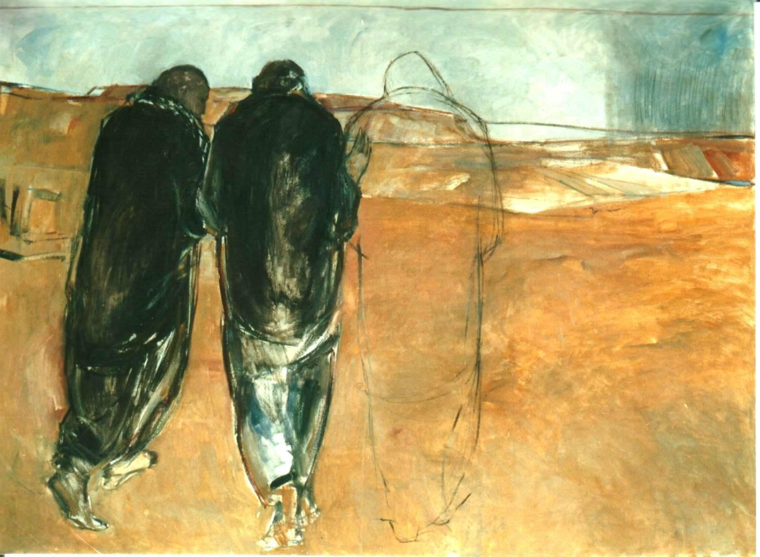
The Emmaus Story Luke 24:13–35
A journey of:
Confusion
Companionship
Revelation
Renewed purpose
Notes:
Read

Slide 8
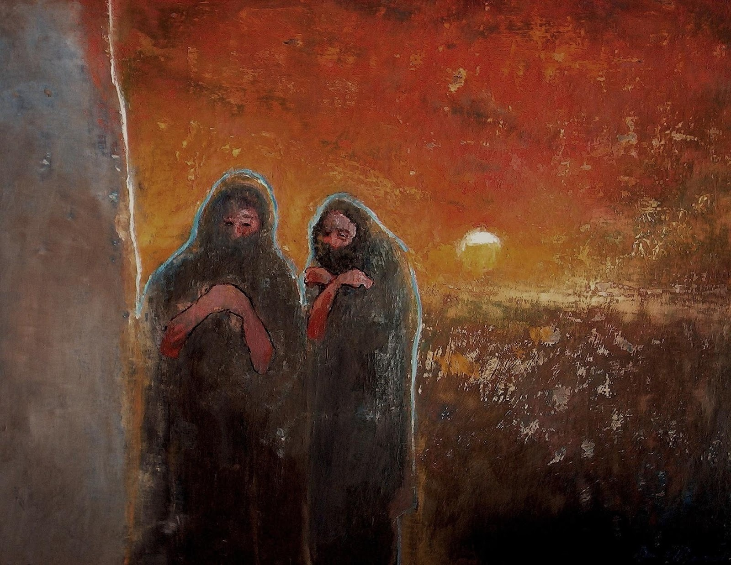
Four Movements of Emmaus
Walking with – accompaniment
Listening deeply – discernment
Hearts burning – formation
Sent forth – mission
Notes:
Facilitator Script — Slide #8: Emmaus Scripture Exploration
“As we look at this artwork, let’s enter the Emmaus story with fresh eyes.”
“On the road to Emmaus, we see four powerful movements that speak deeply to our own vocation as educators and leaders.”
1. Walking With — Accompaniment
“First, notice how Jesus simply joins the two disciples on their journey. He doesn’t interrupt, correct, or give answers right away. He walks with them in their confusion. This is the essence of accompaniment — meeting people where they are, honouring their pace, and staying beside them even when they don’t yet recognise Christ’s presence.” (grounded in the story’s opening lines where Jesus walks alongside them)
2. Listening Deeply — Discernment
“Next, Jesus listens. He asks, ‘What are you discussing?’ and lets them tell their story — their grief, their disappointment, their honest admission: ‘We had hoped…’ This is discernment. It begins with deep listening, with making space for truth, emotion, and experience. Jesus models the kind of listening that allows people to find clarity and meaning.” (grounded in their conversation with Jesus)
3. Hearts Burning — Formation
“As Jesus opens the Scriptures, something awakens in them. Later they say, ‘Were not our hearts burning within us?’ This is the movement of formation. Their hearts are stirred, their understanding expands, and hope rekindles. True formation is never only intellectual — it is a transformation of the whole person.” (grounded in the disciples’ reflection on their burning hearts)
4. Sent Forth — Mission
“Finally, once they recognise Jesus in the breaking of the bread, they don’t stay where they are. They get up at once and go back to Jerusalem to share the good news. This is mission — the natural outflow of an encounter with Christ. When hearts burn, feet move. They return strengthened, hopeful, and ready to witness.” (grounded in their immediate return to Jerusalem to proclaim the encounter)

Slide 9
Check For Understanding
According to the definitions provided, how is vocation different from a profession or career path?
What does mission mean in the context of Catholic education?
How does the Emmaus story illustrate the themes of confusion, companionship, revelation, and renewed purpose?
Notes:
Take some time to think and discuss these questions.

Slide 10

Engage
Discipleship is a personal encounter with Jesus Christ that leads a person to engage more deeply with the life of faith and embark on a lifelong journey as a member of the Church. Thus, discipleship invites us to:
encounter Jesus, and to respond to this initial encounter by following him
engage with the kerygma, assimilating it into every aspect of life as we grow in knowledge and love of Jesus
embark on a life of mission as we discern the unique call of Jesus to share the Gospel, build the kingdom and convey the joy of the Good News to others.

Slide 11
Mission, Vocation & Hope
Engage
From Drawing New Maps of Hope:
“education is one of the Church’s primary ways of living out its mission and that educators themselves have a vocation—a call—to form hearts, minds, and communities in the light of the Gospel.”
Notes:
The Apostolic Letter Drawing New Maps of Hope strongly re‑affirms that education is one of the Church’s primary ways of living out its mission and that educators themselves have a vocation—a call—to form hearts, minds, and communities in the light of the Gospel.

Slide 12
Mission, Vocation & Hope
Engage
From Drawing New Maps of Hope:
Education forms “the very fabric of evangelization… the Gospel becomes an educational gesture, a relationship, a culture.” (Preamble 1.1)
When guided by Christ, communities “do not retreat, but are revitalized; they do not build walls, but bridges.” (Preamble 1.1)

Slide 13
Mission, Vocation & Hope
Engage
From Drawing New Maps of Hope:
Catholic education is a collective endeavour
Educators live a profession of promises
Schools are living environments of faith, culture, life
Educators cultivate:
A heart that listens
A gaze that encourages
An intelligence that discerns

Slide 14
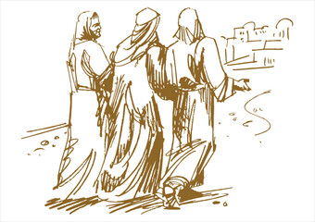
Vocation as “burning within them”
Like Emmaus, educators feel a pull toward:
Accompaniment
Compassion
Courageous hope
Your vocation is:
Evangelising
Relational
Hope‑bearing
Transformative

Slide 15
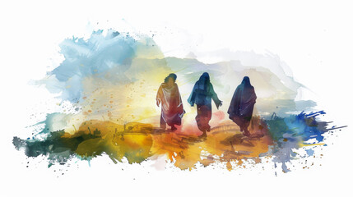
Towards Deeper Learning
1. How does the Emmaus story help us see that education is more than teaching — that it is an act of walking with others in hope, just as Drawing New Maps of Hope describes?
2. In what ways do the disciples’ hearts “burning within them” help us understand our vocation as educators to inspire meaning, purpose, and hope in our students?
3. How do both the Emmaus journey and Drawing New Maps of Hope challenge us to see our work not just as a job, but as a shared mission grounded in accompaniment, relationship, and the Gospel?
Notes:
TASK:
Each staff member chooses 1 question to think about. Spend a few minutes jotting down ideas.
Find a staff member with the same question. Share ideas
Find a staff member with a different question. Share responses
Find a staff member with a different question. Share responses

Slide 16

Walking in the Footsteps of St Patrick
St Patrick models:
Walking with the marginalised
Listening deeply
Courage in mission
Evangelising through relationship
Hope in uncertainty
Reflection Prompt: Where am I called to walk in Patrick’s footsteps?

Slide 17
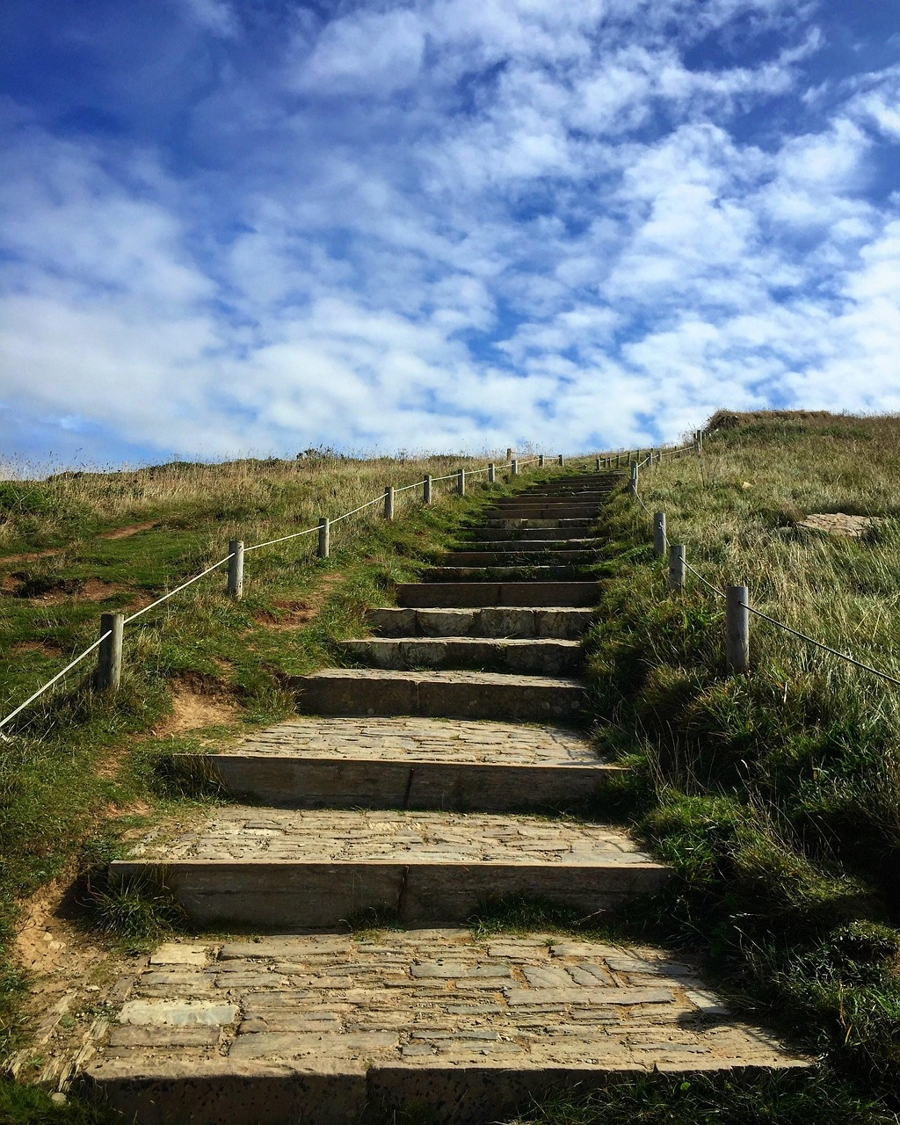
Embark
Discipleship is a personal encounter with Jesus Christ that leads a person to engage more deeply with the life of faith and embark on a lifelong journey as a member of the Church. Thus, discipleship invites us to:
encounter Jesus, and to respond to this initial encounter by following him
engage with the kerygma, assimilating it into every aspect of life as we grow in knowledge and love of Jesus
embark on a life of mission as we discern the unique call of Jesus to share the Gospel, build the kingdom and convey the joy of the Good News to others.

Slide 18

Catechesis and Evangelisation
Embark
As educators, we are invited to recognise that:
Christ still walks with us on our own Emmaus roads.
We are called to draw new maps of hope for the students and communities entrusted to us.
We, like St Patrick, carry the Gospel not only in our words but in our presence, relationships, and everyday gestures.

Slide 19
Where in the Emmaus story do you see Christ forming the disciples for mission, and how does this help you understand your own vocation as a Catholic educator today?
The disciples’ hearts “burned within them” as Jesus opened the Scriptures. Where in your work do you experience Christ igniting meaning, purpose, or hope and how might this become part of your evangelising presence in your school?
After recognising Jesus, the disciples are immediately “sent forth.” What is one concrete way you feel called to witness the Good News in your role, through gentleness, accompaniment, courage, or service in the term/year ahead?

Slide 20
Closing Prayer
Name one small action you will take this term to embody your vocation...
Choreographers of hope… Tireless seekers of wisdom… Creators of expressions of beauty. May Christ walk with us, set our hearts on fire, and send us forth as witnesses of hope.

Slide 21

