Slide 1
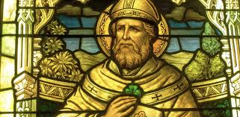
The Footsteps of St Patrick Discipleship in Action: Witness, Stewardship, and the Call to Serve
Laudato Si` and Laudato Deum

Slide 2
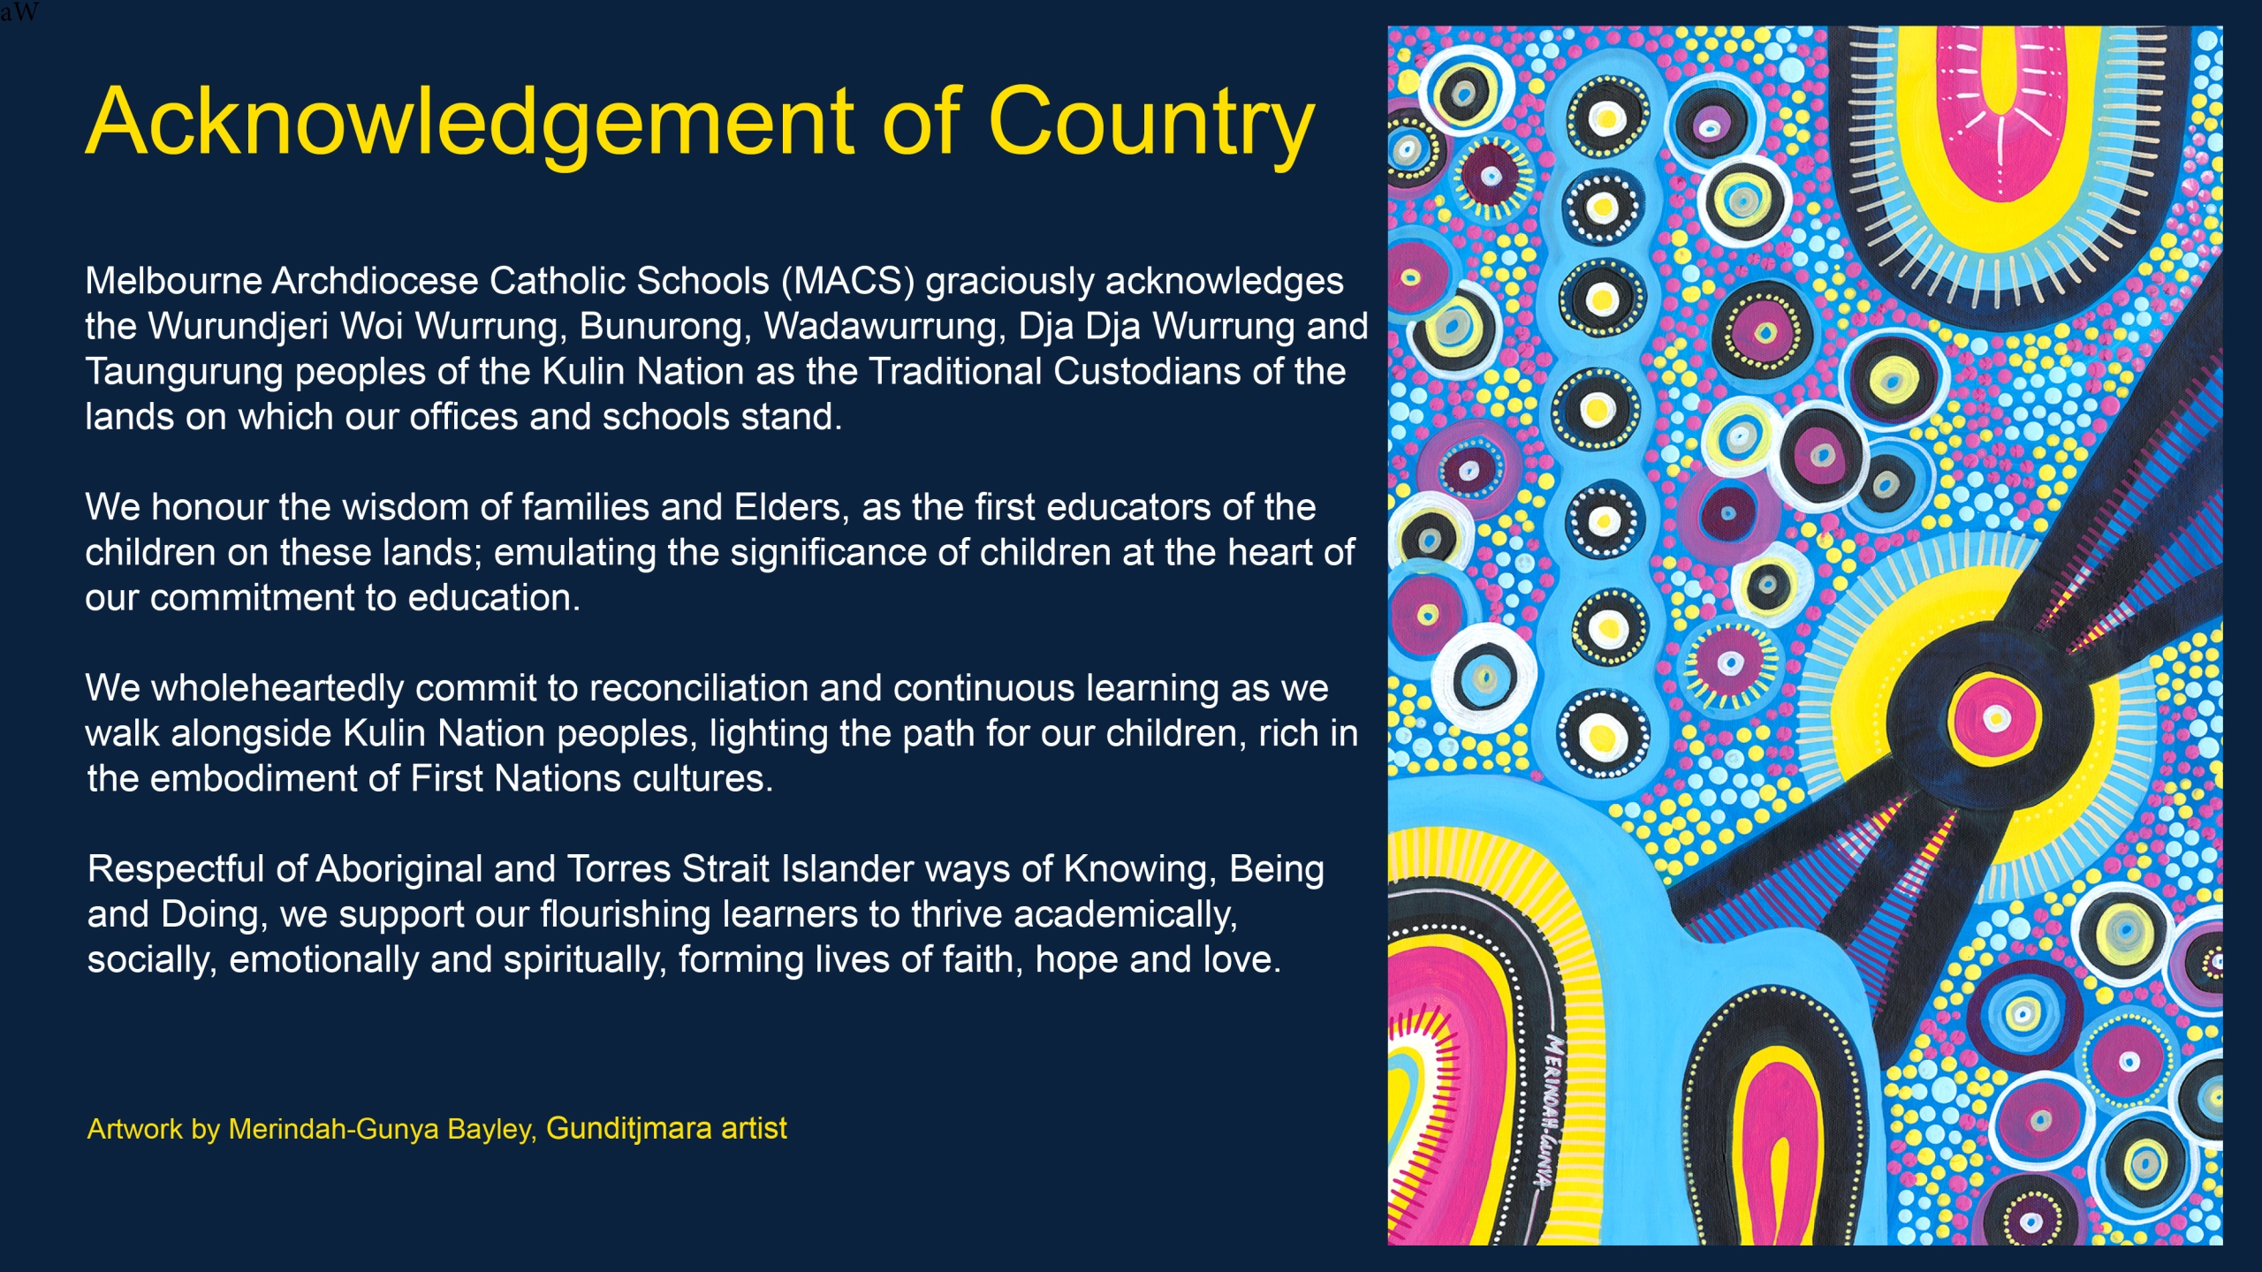
Notes:
Carmela

Slide 3
Cognitive Outcomes
Understand discipleship as learning and imitation.
Learn from St Patrick as a model of gradual formation.
Embrace stewardship as part of discipleship.
Affective Outcomes​
Respond to God’s call with courage, even when we feel unprepared.​
Deepen commitment to witness and service.​

Slide 4
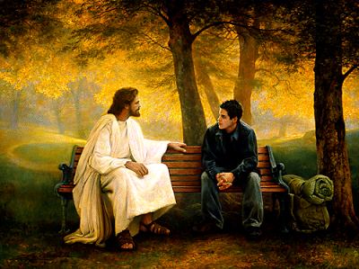
Encounter
Discipleship is a personal encounter with Jesus Christ that leads a person to engage more deeply with the life of faith and embark on a lifelong journey as a member of the Church. Thus, discipleship invites us to:
encounter Jesus, and to respond to this initial encounter by following him
engage with the kerygma, assimilating it into every aspect of life as we grow in knowledge and love of Jesus
embark on a life of mission as we discern the unique call of Jesus to share the Gospel, build the kingdom and convey the joy of the Good News to others.
Notes:
Full article: Discipleship: Encountering Jesus
Artwork by: Greg Olsen

Slide 5
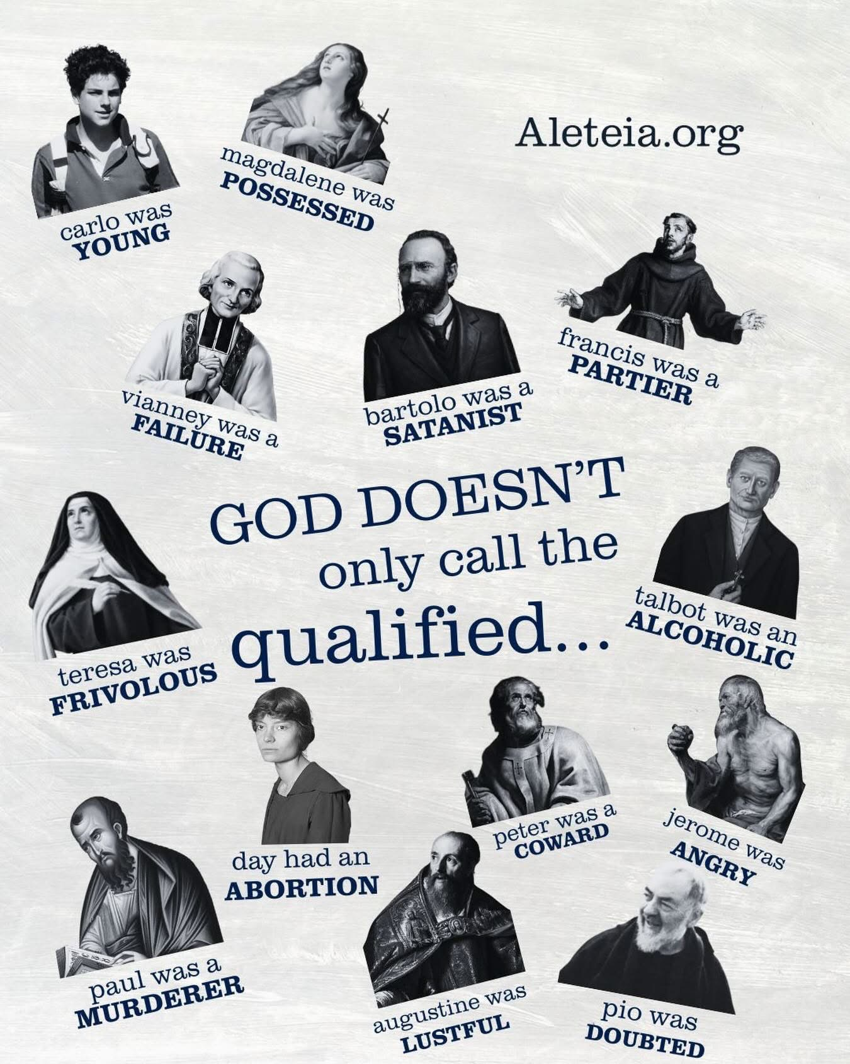
GOD DOESN’T CALL THE QUALIFIED,
HE QUALIFIES THE CALLED
Notes:
LINK TO ARTICLE: https://linksplayers.com/2023/07/27/god-does-not-call-the-qualified-he-qualifies-the-called/
Who am I? (Ex. 3:11)
Walking into the position of National Women’s Director for Links Players International last August was a thrilling yet overwhelming experience. It marked the beginning of a crucial phase in establishing a solid foundation for the women’s ministry.
While I didn’t find the task of building this foundation daunting, I faced challenges in overcoming natural fears associated with such a role.
Would the women accept me as their leader? What if I made a wrong ministerial decision and failed? How could I unite the existing women with the newcomers in the women’s fellowships? And would my relatively younger age hinder their ability to take me seriously?
These questions swirled in my mind, reminiscent of Moses when God called him to lead his people out of slavery. Moses’ initial response was, “Who am I (Exodus 3:11)?” And God’s reassuring answer to him was, “I will be with you.”
Have you ever felt underqualified for a significant task? Has this feeling prevented you from taking that leap of faith and trusting in God despite your fears and doubts?
It’s essential to put such fears and feelings into perspective.
The truth is that none of us are ultimately qualified. As Psalm 103 eloquently expresses, “The LORD is like a father to his children, tender and compassionate to those who fear him. For he knows how weak we are; he remembers we are only dust” (Psalm 104:13-14). Additionally, Isaiah reminds us that even our best efforts are akin to filthy rags (Isaiah 64:5).
So, what truly qualifies us, then?
Jesus is the only one who can qualify us. The Apostle Paul reminds us, “For we are God’s handiwork, created in Christ Jesus to do good works, which God prepared in advance for us to do (Ephesians 2:10).”
Jesus does not call the qualified; rather, he qualifies the called. Calling the unqualified has always been God’s specialty. We can look to the heroes of our faith in the past—David, Solomon, Joseph, Esther, Ruth, Moses, Miriam, Deborah, Lydia, and the list goes on.
Therefore, we must continue to step out in faith, embracing the Lord’s calling upon our lives and trusting him to guide us every step of the way. As the psalmist proclaims, “My help comes from the Lord, the Maker of heaven and earth” (Psalm 121:1). We may not be worthy or feel worthy, but there is only one who is truly worthy, and that is Jesus Christ, as revealed in Revelation 1:17-18.
Hence, we must step out in faith and obedience, serving the Lord’s Kingdom without allowing fears and feelings to dictate our destination and his call on our lives.
As believers in Christ, we have been purchased at a price and redeemed by His shed blood. As the Apostle Paul proclaims, “He saved us and called us to a holy calling, not because of our works but because of his own purpose and grace, which he gave us in Christ Jesus before the ages began, and which has now been manifested through the appearing of our Savior Christ Jesus, who abolished death and brought life and immortality to light through the gospel” (2 Timothy 9-10).
The Lord has graciously provided you with all the necessary tools and resources for today as you fulfill your calling in the Kingdom. You have been called, and each day, you will receive the necessary equipping to carry out your purpose.

Slide 6
Reflect on a time you learned a new skill:
Why did you want to learn it (investing your time in doing so)?
What was the learning process like?
Was it challenging? In what ways?
How did you feel when you mastered the skill? Did it change you?
What does it mean to consider disciples as learners? What might Jesus expect from us?

Slide 7

WHAT IS A DISCIPLE? LEARN, GET SENT OUT TO HAVE A GO, HAVE A GO, MAKE MISTAKES, REPEAT!

Slide 8
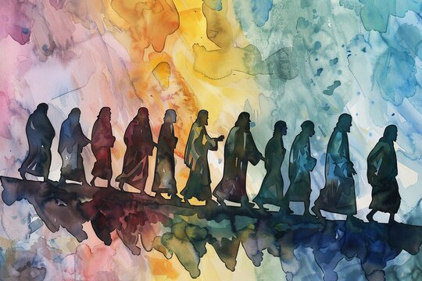
What is a Disciple?
Mathētēs = “pupil” or “student”
Discipleship = lifelong apprenticeship to Jesus Christ
Becoming a friend and follower of Christ through relationship and imitation
Intentional Discipleship
Living out our identity in Christ
Imitating Jesus, the model of true humanity
Growing into the person God created us to be
Responding to the Call
The call to discipleship is universal
Open to anyone willing to respond to Christ’s love
A choice to align one’s life with Jesus
Living the Call
Evangelising by sharing the Gospel and personal witness
Fulfilling the Great Commission (Mt 28:19–20)
Praying for renewal and participating in the mission of evangelisation
Service as Discipleship
Serving others with love, mercy, and healing
Stewardship: giving of oneself without counting the cost
Mary as the first disciple—total trust, surrender, and service
God Qualifies the Called
We are God’s handiwork, created for good works (Eph 2:10)
God often calls the unprepared and equips them through grace
Biblical examples: David, Ruth, Moses, Deborah, Lydia, and more
Stepping Out in Faith
Trusting God’s guidance despite fear or inadequacy
“My help comes from the Lord” (Ps 121:1)
Christ alone is worthy and strengthens those he calls

Slide 9
Check for Understanding
SUMMARISE IN 3 WORDS!
What does the Greek word mathetes mean, and how does it shape our understanding of discipleship?
Why is discipleship described as a lifelong learning journey rather than a one-time decision?
How does learning lead to transformation in the life of a disciple?

Slide 10

Engage
Discipleship is a personal encounter with Jesus Christ that leads a person to engage more deeply with the life of faith and embark on a lifelong journey as a member of the Church. Thus, discipleship invites us to:
encounter Jesus, and to respond to this initial encounter by following him
engage with the kerygma, assimilating it into every aspect of life as we grow in knowledge and love of Jesus
embark on a life of mission as we discern the unique call of Jesus to share the Gospel, build the kingdom and convey the joy of the Good News to others.

Slide 11
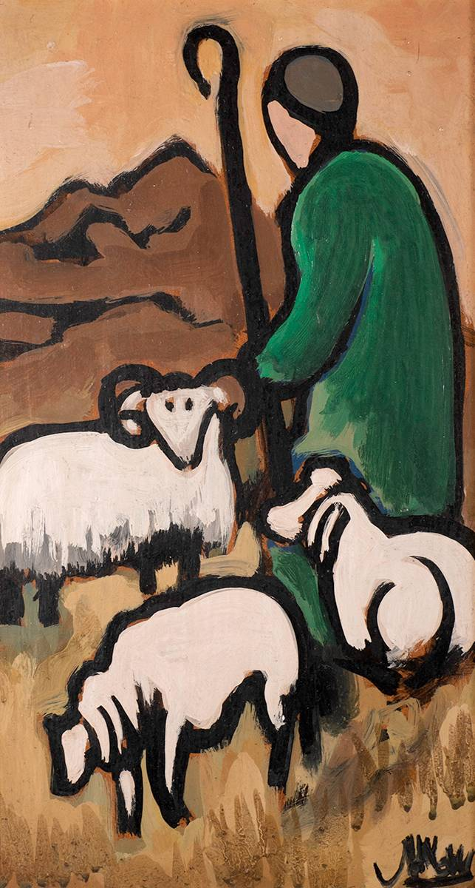
Was St. Patrick already qualified?
1. Captured as a teenager
2. Lack of formal education
3. Fear and self-doubt about returning to Ireland
4. Facing opposition and danger
Notes:
ST. PATRICK AND HIS SHEEP
Markey Robinson (1918-1999)1. Captured as a teenager Patrick was only about 16 when he was kidnapped and taken to Ireland as a slave. He had no training, status, or preparation for leadership or mission. This period, however, became the place where his prayer life deepened and his faith began to grow.
2. Lack of formal education Patrick later wrote that he felt poorly educated compared to trained clergy of his time. He worried that he was not intellectually qualified to preach or teach the faith, yet God still called him to evangelise Ireland.
3. Fear and self-doubt about returning to Ireland After escaping slavery, Patrick received a sense of calling to return to the very land where he had suffered. He hesitated because he felt inadequate, afraid, and unsure whether he was capable of such a mission.
4. Facing opposition and danger When he began missionary work, Patrick entered a culture unfamiliar with Christianity and often hostile to it. He had little political power or protection, yet continued his mission with trust in God rather than relying on personal strength.

Slide 12
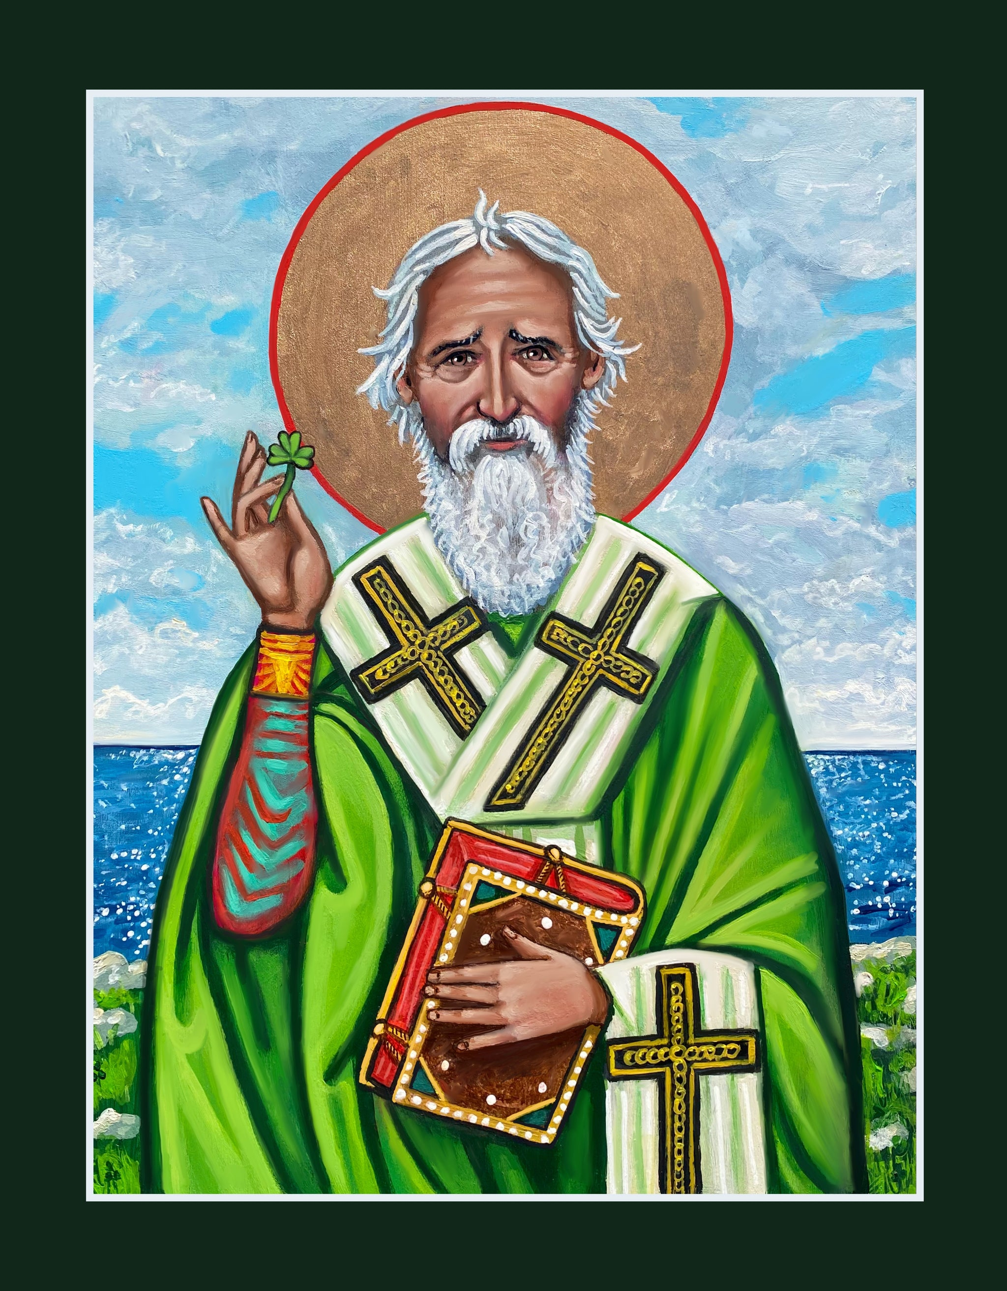
So how did God qualify St. Patrick?
1. Formed him through suffering
2. Gave him spiritual conviction and calling
3. Provided learning and Church formation
4. Strengthened him through perseverance in mission

Slide 13
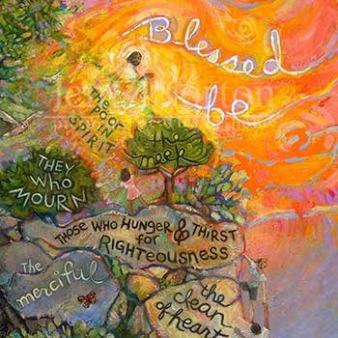
Scripture: The Beatitudes
1. St. Patrick was kidnapped, enslaved, and later forgave the people who hurt him. How does his response reflect the Beatitude “Blessed are the merciful”?
2. Patrick returned to Ireland even after suffering there to share his faith. In what ways does this show the spirit of “Blessed are the peacemakers”?
3. St. Patrick stood up for his beliefs despite danger and criticism. How does his courage connect to “Blessed are those who are persecuted for righteousness”?
4. What am I called to BE and DO as a member of a Catholic School Community
Notes:
The Beatitudes - a concise summary
Read the passage once without interruption,
Read it again with pauses at different phrases and ask questions 1-3 as you reach the relevant phrase.
The Beatitudes teach what it looks like to live as part of God’s kingdom. Instead of focusing on power, wealth, or status, Jesus highlights qualities like humility, mercy, justice, compassion, and courage. They describe the kind of heart and attitude that reflect God’s love in the world.
At their core, the Beatitudes show that true happiness and blessing come from living God’s way, even when it’s difficult or countercultural.
1. St. Patrick was kidnapped, enslaved, and later forgave the people who hurt him. How does his response reflect the Beatitude “Blessed are the merciful”?
2. Patrick returned to Ireland, even after suffering there, to share his faith. In what ways does this show the spirit of “Blessed are the peacemakers”?
3. St. Patrick stood up for his beliefs despite danger and criticism. How does his courage connect to “Blessed are those who are persecuted for righteousness”?

Slide 14

To reflect on...
When have I felt unprepared or uncertain in my vocation, yet sensed God inviting me to step forward?
Like St Patrick, what experiences of challenge have strengthened my faith and leadership?
Where do I need to trust that God will equip me, even if I do not yet feel ready?
How can our staff community support one another in responding courageously to God’s call?

Slide 15
Discipleship in Laudato Si' and Laudate Deum
Through the lens of Laudato Si’ and Laudate Deum, being “qualified” by God means growing into our vocation while living it. As we care for people, community, and creation, God shapes us into the leaders and educators our world needs.
Notes:
39. Postmodern culture has generated a new sensitivity towards the more vulnerable and less powerful. This is connected with my insistence in the Encyclical Letter Fratelli Tutti on the primacy of the human person and the defence of his or her dignity beyond every circumstance. It is another way of encouraging multilateralism for the sake of resolving the real problems of humanity, securing before all else respect for the dignity of persons, in such a way that ethics will prevail over local or contingent interests.

Slide 16
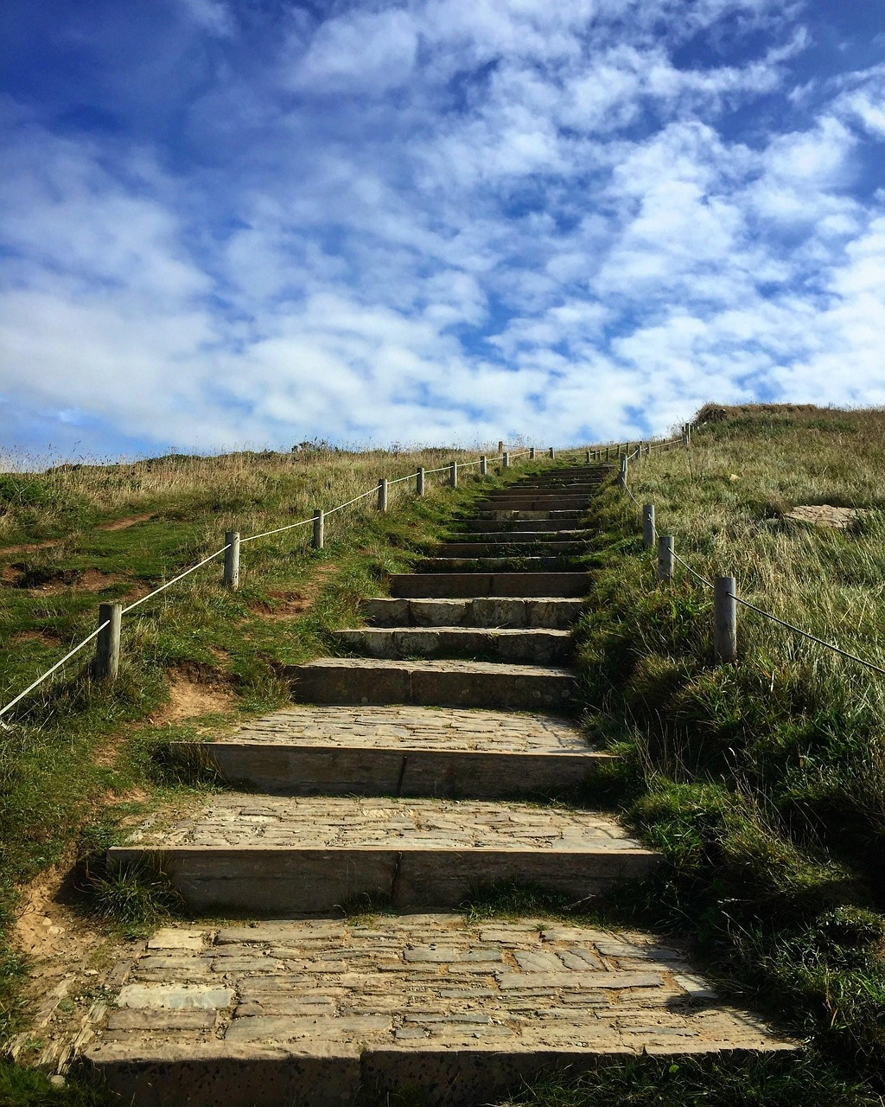
Embark
Discipleship is a personal encounter with Jesus Christ that leads a person to engage more deeply with the life of faith and embark on a lifelong journey as a member of the Church. Thus, discipleship invites us to:
encounter Jesus, and to respond to this initial encounter by following him
engage with the kerygma, assimilating it into every aspect of life as we grow in knowledge and love of Jesus
embark on a life of mission as we discern the unique call of Jesus to share the Gospel, build the kingdom and convey the joy of the Good News to others.

Slide 17
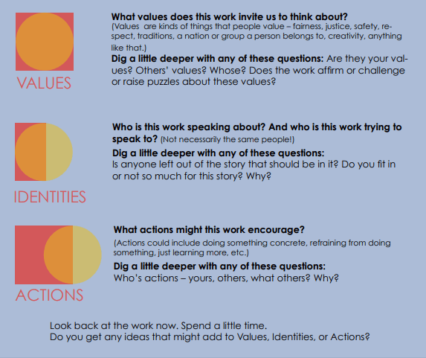
Embark: Visible Thinking Routine: Values, Identities and Actions
Notes:
Visible Thinking Routine: Connect – Extend – Challenge
Step 1: Connect
Ask staff to reflect individually, then discuss in pairs:
How do the ideas in these documents connect with what we already believe about Catholic education and discipleship?
Where do we already see these teachings lived in our school community?
Step 2: Extend
Invite staff to consider:
What new thinking or deeper understanding about discipleship do these documents offer?
How does this extend our understanding of our role beyond teaching subjects to forming people and caring for creation?
Step 3: Challenge
Staff reflect and share:
What challenges do these teachings present for our school or for me personally?
What is one practice we may need to rethink, strengthen, or begin to live more fully as missionary disciples?

Slide 18

Catechesis and Evangelisation​
When classrooms intentionally connect faith, learning, and action, students begin to understand discipleship not as a concept but as a way of living.

Slide 19
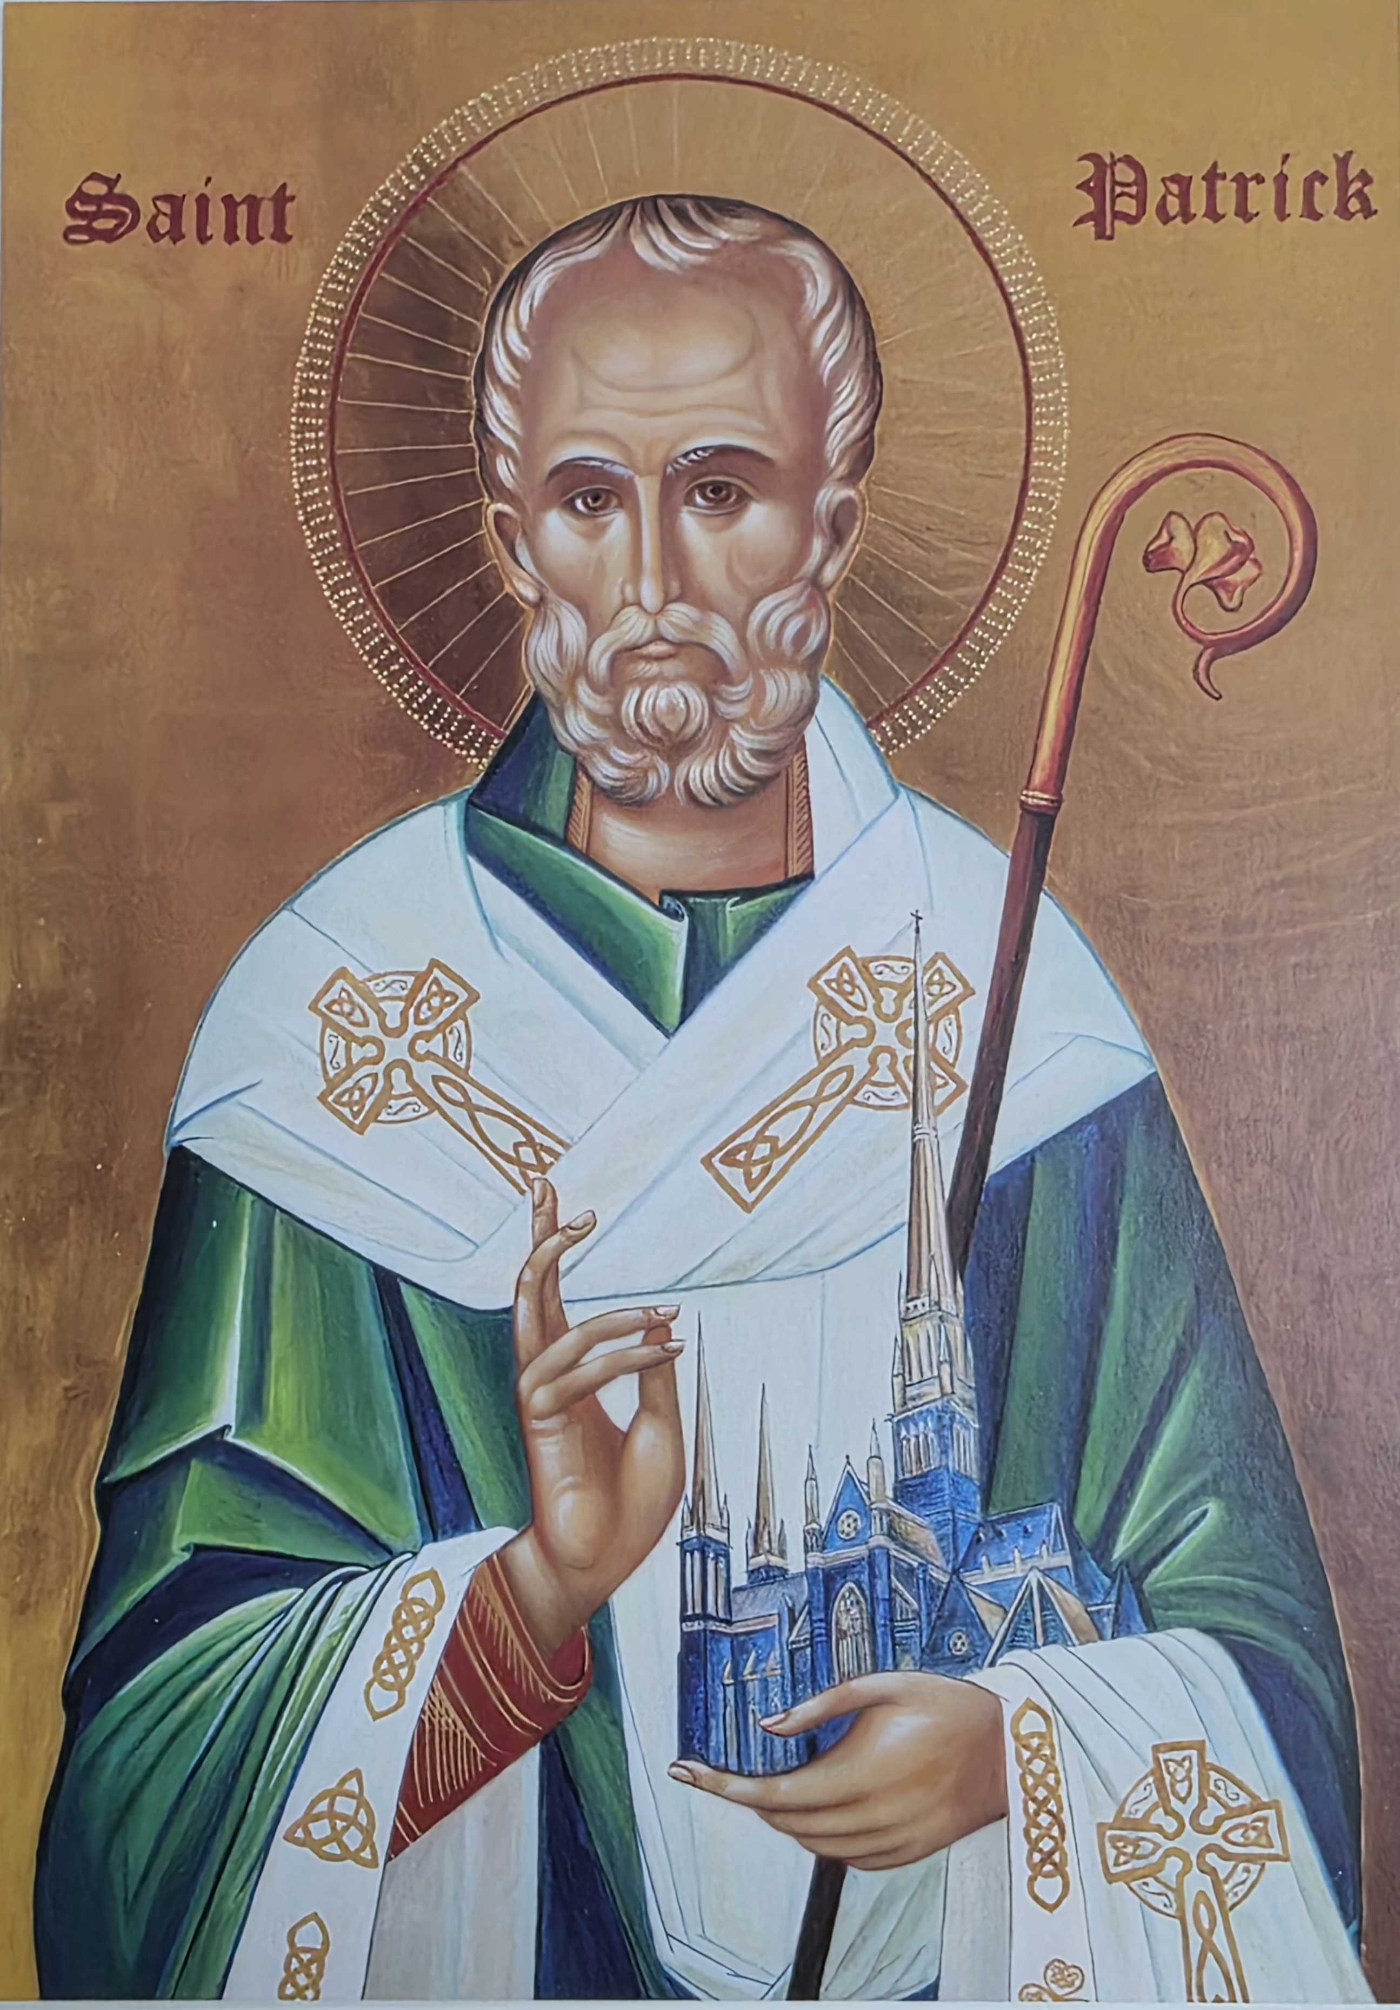
Catechesis and Evangelisation
1. Teaching for stewardship
Integrate environmental responsibility across learning areas.
Encourage students to see care for creation as part of their faith identity.
2. Formation of action-oriented learners
Provide opportunities for service, justice projects, and sustainability initiatives.
Help students connect Gospel values with real-world actions.
3. Modelling discipleship
Teachers model compassion, responsibility, and ethical decision-making.
Classroom routines reflect respect for people, resources, and the environment.
4. Building reflective learners
Use reflection questions that help students ask: “How can I care for others and the world today?” “How can my choices make a difference?”

Slide 20
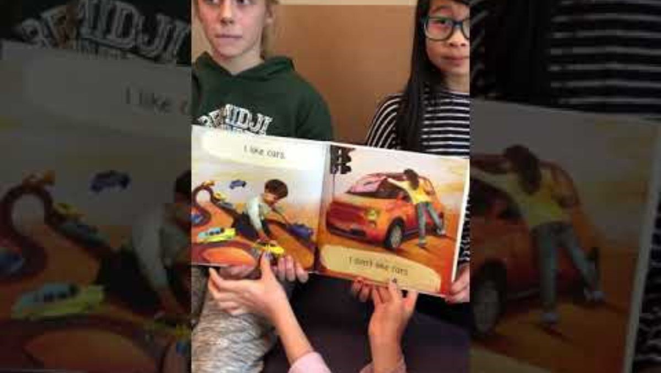
I Like, I don't Like... by Anna Baccelliere Think-Pair Share/Reflection for Students
Notes:
https://www.youtube.com/watch?v=ndCVESc48Y0

Slide 21

Examine past and current Social Justice Statements by the Justice and Peace Office and identify the key messages that challenge us to live and act as disciples of Christ.

Slide 22
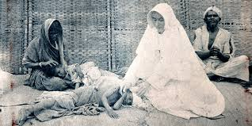
Explore your school’s Charism or the saint your school is named after. Students build a timeline of the person’s life and work ensuring that they include significant moments from their lives and outline the contribution they have made to the life and mission of the Church.
Sr Mary Glowrey
Dr Sr Mary Glowrey JMJ (1887-1957) was a Victorian born and educated doctor. In January 1920 she went to Guntur, India, where she became a religious Sister. She was known as Sr Mary of the Sacred Heart JMJ. She spent the rest of her life serving the medical and spiritual needs of the most marginalised people. The Catholic Church declared Mary Glowrey a Servant of God in 2013 and Pope Leo XIV recognised her ‘heroic virtues’ on 21 November 2025 and she is now titled Venerable Mary of the Sacred Heart Glowrey.

Slide 23
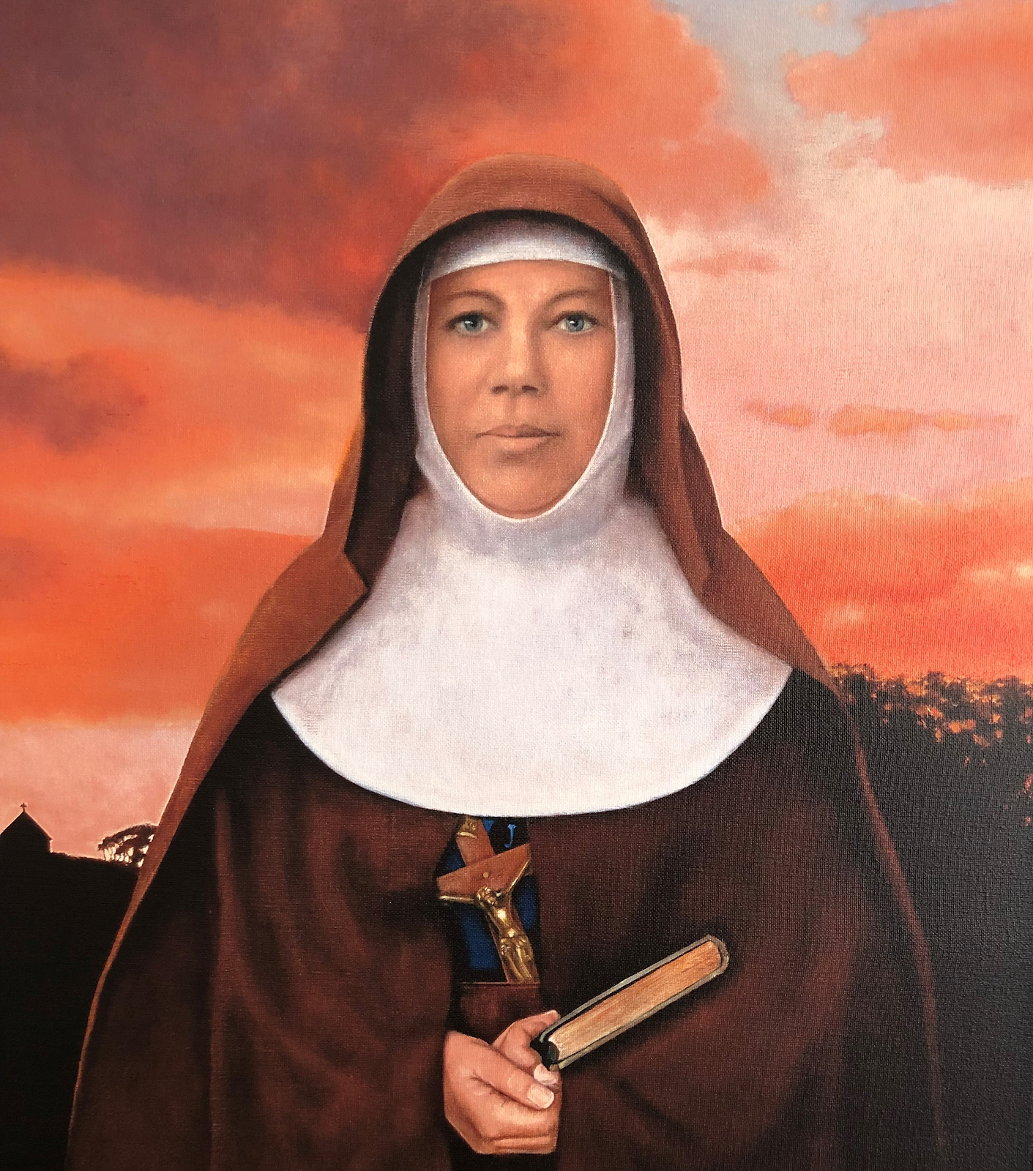
St Mary of the Cross Mackillop
St Mary of the Cross McKillop. She was born in Melbourne in January 1842 and spent most of her childhood and early adulthood in Victoria and is Australia’s first Saint. Together with the Reverend Julian Tenison-Woods, she founded the Sisters of St Joseph of the Sacred Heart (the Josephites), a congregation of religious sisters that set up a number of schools and welfare institutions throughout Australia

Slide 24

