Slide 1
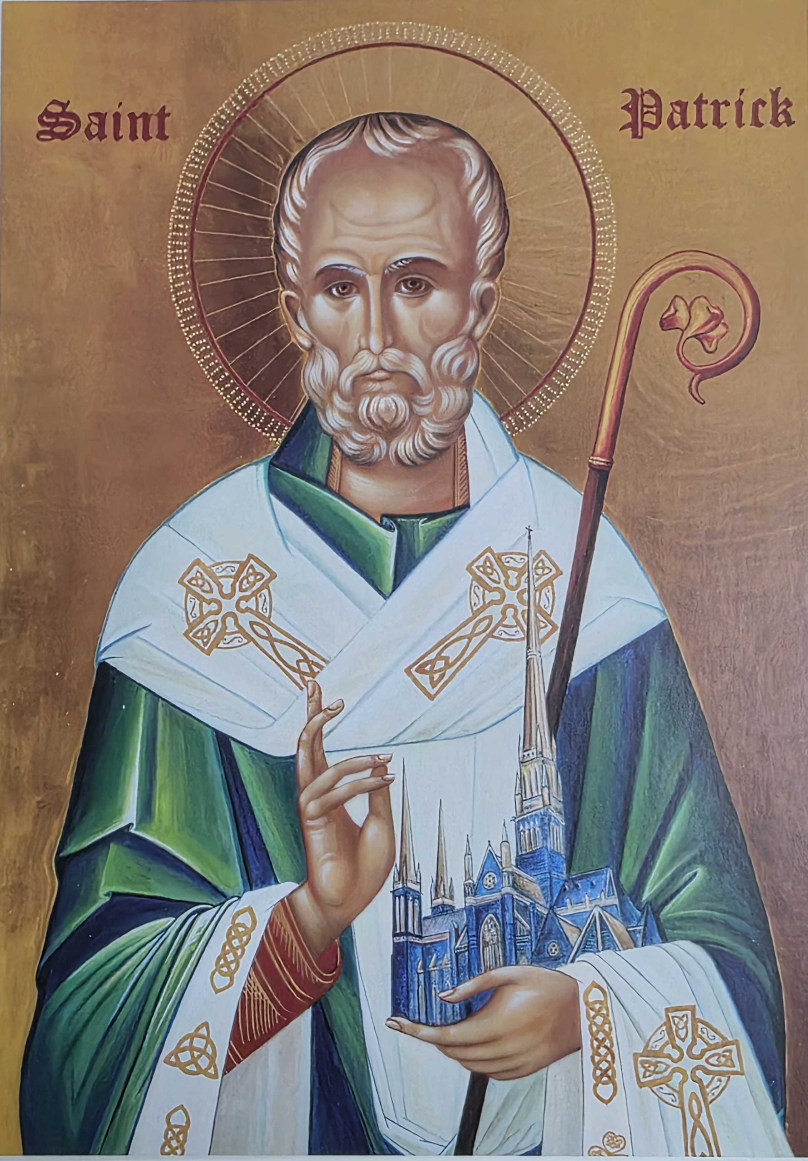
CATHOLIC EDUCATION WEEK RESOURCES
Theme
Christ beside me: Walking in the footsteps of Saint Patrick

Slide 2
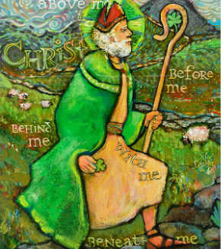
Catholic Education Week is an opportunity for all Catholic schools in the Archdiocese of Melbourne to celebrate their Catholic identity, the pivotal role they play within their local community and the strength of the sector.
This year’s theme celebrates the significance of Saint Patrick, the patron saint of our local Church in Melbourne.
Christ beside me: Walking in the footsteps of Saint Patrick.
Saint Patrick’s Cathedral, our mother Church, is named after the saint of Ireland, and is a reminder that Australia’s migrants have always brought their religion with them. His legacy offers us powerful lessons in love, faith and courage.

Slide 3

PRAYER EXPERIENCES
CLICK TO ACCESS THE SLIDE BELOW
FORMATION FOR STUDENTS
VATICAN LINKS
SPIRITUAL EXPERIENCES
MUSIC RESOURCES
WHOLE SCHOOL EXPERIENCES
ADDITIONAL EXPERIENCES

Slide 4
Key Concepts:
Mercy: He forgave his captors and returned to share God’s love with them.
Courage: He preached Christ in places of danger and hostility.
Recognition of the Poor: He walked among enslaved and forgotten people.
Evangelisation: Baptised, confirmed, and taught about God’s limitless love.

Slide 5
Opportunities for Prayer
Christ’s Love in Our Hearts
Leader: Lord Jesus, your love transforms hearts. All: Fill our hearts with Your compassion.
Leader: Like St Patrick, help us see Christ in those who suffer. All: Christ, help us walk with the poor and forgotten.
Leader: Teach us to listen, forgive, and bring peace. All: Make us instruments of Your loving mercy.
Leader: Send us on mission to love boldly. All: Christ’s love in our hearts, Christ’s love in our hands, Christ’s love in our world. Amen.

Slide 6
Opportunities for Prayer
Lenten Prayer of St Patrick
Christ be with me today. Christ be in my heart. Christ be in my friends. Christ be in those who need help. Christ be in the lonely and afraid. Christ be in everyone I meet. Amen.

Slide 7
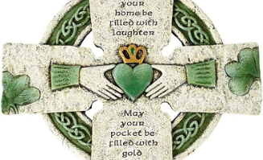
Celtic Spirituality Experience
Check Notes Section for Facilitator Guide
Notes:
Set-up : Green cloth, A Celtic cross image or simple wooden cross, Bowl of water (creation + baptism), Candle (light of Christ), Stones or leaves
Leader Script (simple, calm): “Celtic Christians believed God is very close — in the wind, the trees, the sun, and in our courage to do good.”
Action: Light the candle slowly. Invite students to sit in a circle. 30 seconds of quiet listening
God in Creation – Sensory Prayer:
Pass around a stone or leaf
Students hold it quietly
“Feel it in your hand…”
“God made the earth…”
“God is with us right now…”
Call-and-response prayer: Leader: God is in the earth Students: God is here Leader: God is in the sky Students: God is here Leader: God is in my heart Students: God is here
Tell the story (short & visual):
Patrick was once afraid
God stayed close
He trusted God and helped others
He used the shamrock to explain the Trinity
Discussion prompts (choose 2):
When do you feel brave?
When do you need God’s help?
How can we be kind even when it’s hard?
Celtic theme: Courage grows when we know God walks beside us.
“Thin Places” Reflection: Celtic Christians believed some moments feel closer to God. They called them thin places
Student reflection (eyes closed):
Choose/imagine:
A place you feel calm
A time you feel loved
A moment you feel safe
Optional drawing option: Students draw their “thin place” on paper.
Gentle Movement: Celtic prayer is rhythmic, repeated, and embodied.
Slow walking in a circle
With each step, whisper: “God walks with me”
Simple Celtic-style chant
Repeated line: “Christ beside me, Christ within me”
Closing Blessing: Celtic Style
May God be in your heart, May God be in your words, May God be in your steps today, And may you know you are never alone. Amen.”

Slide 8
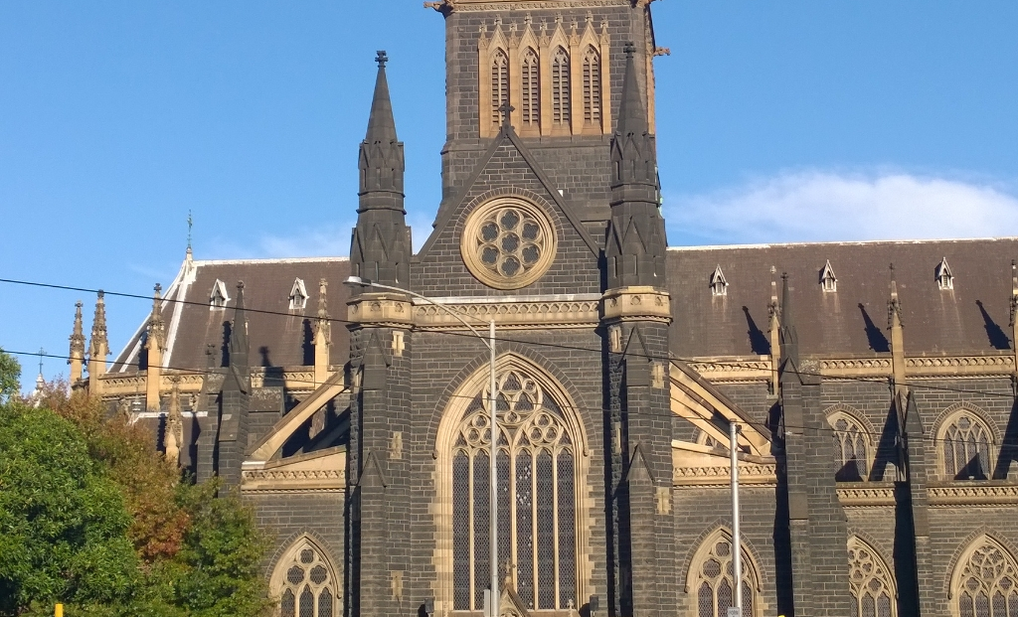
Lectio Divina on St Patrick’s Cathedral, Melbourne
Check Notes Section for Facilitator Guide
This Photo by Unknown Author is licensed under CC BY-SA
Notes:
Opening Prayer
Invite the students to settle, breathe deeply, and focus on God’s presence: Lord, open our hearts to your Word. Help us listen with faith as we reflect on Scripture and the living faith of your people. Amen.
Read the Scripture slowly, twice:
Matthew 16:18–19 “But I tell you, you are Peter, and on this rock I will build my Church. I will give you the keys of the kingdom of heaven…”
Then quietly read it a second time. Let the words settle we’re listening for what God wants to say today.
Ask students to reflect silently or draw/mind-map answers to these questions:
What word or phrase stands out to you? (e.g., “Church”, “rock”, “built”)
How does this connect with St Patrick’s Cathedral in Melbourne? This cathedral was built over many years because the early Catholic community wanted a place to worship and call home; it became a sign of faith for Irish settlers and all Catholics in Melbourne.
How is your life like a “church” of God today?
Give 2–3 minutes of silence; then invite volunteers to share.
Invite students to talk to God in their own words, using these prompts:
Thank you, God, for the people who built and cared for St Patrick’s Cathedral.
Help me build kindness and love in my school community, like a living part of your Church.
Guide me to be a person who brings peace, just like Jesus promised Peter and the apostles.
Ask them to imagine standing inside St Patrick’s Cathedral (real or in their mind’s eye):
The tall spires reaching to the sky;
The quiet hush as people pray;
The light through stained glass;
Reflect silently: How does God feel close to you when you think about this place where people gather to worship?
Prayer:
God of our hearts and our Church, as you called Peter to build your Church, call me to build kindness, faith and love in my life. May I see your presence in places of worship and also in my home and school. Amen.

Slide 9
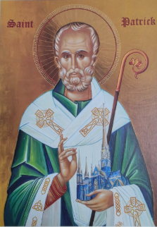
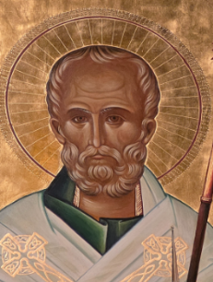
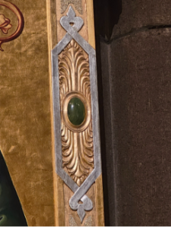
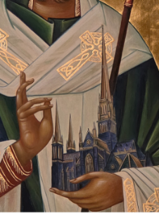
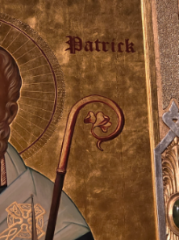
Visio Divina - St. Patrick’s Icon
Check Notes Section for Facilitator Guide
Click Link for Background Information
Notes:
Steps for Visio Divina
Place your image in front of you.
Close your eyes and invite God into your prayer.
Prepare yourself for prayer
Close your eyes
Breathe and clear your mind.
Ask the Holy Spirit to quieten your heart and mind
Sit comfortably with the image before your eyes
Lectio (reading)
“Read” what is in the image or has been “written” in the icon.
What part of the image are you first drawn to?
Focus on just this part of the image and name it.
Close your eyes and see this part of the image in your mind
Open your eyes and look at the whole image – notice the colours, texture, lines, shapes, images …
What aspect of this image is speaking to you?
Close and rest your eyes a moment
Meditatio (meditation).
Engage your intellect and emotions. Seek to understand what God might be saying to you in this artwork.
Ask yourself questions about the artwork.
Let your eyes gaze at the whole image. See it all.
What emotions does the image evoke in you?
What does the image stir up or bring forth for you?
What hooks you? What shimmers?
What thoughts are coming to mind? Does it remind you of certain experiences, people or issues in your life?
Imagine yourself in this artwork: what do you see, experience from this perspective?
How does this image illuminate your relationship with others, the world, and God?
Oratio (prayer)
Respond to what you are thinking and feeling. Have an open conversation with God about these thoughts and emotions and what they mean in your life.
Respond in a prayer form that reflects how you are thinking and feeling (e.g. if you are feeling grateful, respond with a prayer of thanksgiving; if you are feeling in need of help or support, a prayer of petition, etc.)
Try to sum up the main gist of your conversation with God
Contemplatio (contemplation)
Open your eyes and gaze at the image.
Rest in the silent presence of God.
Block out all distractions and simply “be” with God.
What is God saying to you today through this image?
Actio (action).
This is a time to respond to the experience of being touched by God through the image and through God’s presence.
Did this experience of prayer open up a new awareness of who you are called to be and what you are called to do?
Has it sparked a conviction to change?
What is God asking me to do or to do differently in my life?
What steps can I take to implement this?

Slide 10
Catholic Education Week 2026 Faith Formation Framework Aligned Experiences
PREP – YEAR 2
Phase | Learning Intention | Teaching & Learning Experiences | Prayer & Scripture | Resources | Evidence of Learning
Encounter | We notice that Jesus is close and walks beside us. | Teacher tells the story of St Patrick. Students sit in a prayer circle with green cloth, candle, and cross. Students draw or share moments they feel God close. Introduce the shamrock to explain the Trinity. | Matthew 19:14 – Jesus welcomes children. | https://app.kwl.com.au/year/0/17/P-17-Jesus_calls_his_disciples https://app.kwl.com.au/year/1/8/1-08-Jesus_Returns_to_the_Father | Drawings, oral responses, prayer participation
Engage | We learn how St Patrick followed Jesus. | Create a Shamrock of Blessings wall. Retell Patrick’s story through drawing or role-play. | Prayer of thanks. | https://app.kwl.com.au/year/2/6/2-06-St_Patrick https://app.kwl.com.au/year/2/12/2-12-signs_of_gods_love | Student explanations and artwork
Embark | We choose to love others like Jesus. | Class chooses a kindness action to practise during CEW. | Sending prayer. | https://app.kwl.com.au/year/2/5/2-05-Saints | Observed actions

Slide 11
Catholic Education Week 2026 Faith Formation Framework Aligned Experiences
YEARS 3–4
Phase | Learning Intention | Teaching & Learning Experiences | Prayer & Scripture | Resources | Evidence of Learning
Encounter | We encounter Christ through scripture and symbol. | Students reflect on the Icon of St Patrick and identify symbols. Silent reflection and sharing. | Luke 10:33–37 – Good Samaritan. | https://melbournecatholic.org/news/a-doorway-to-eternity-st-patricks-cathedral-gets-a-new-icon | Reflections and discussion
Engage | We understand how Jesus guides our choices. | Explore Patrick’s missionary courage. Design a Celtic icon panel showing mission. | Student-written intercessory prayer. | https://app.kwl.com.au/year/3/1/3-01-God_sharing https://app.kwl.com.au/year/4/8/4-08-The_Holy_Spirit_Alive_in_the_Church | Written reflections
Embark | We live faith through mission. | Create a Mission Map of the school or neighbourhood and commit to an action. | Sending prayer. | https://app.kwl.com.au/year/4/1/4-01-God_is_with_us_Father_Son_and_Holy_Spirit | Participation and follow-through

Slide 12
Catholic Education Week 2026 Faith Formation Framework Aligned Experiences
YEARS 5–6
Phase | Learning Intention | Teaching & Learning Experiences | Prayer & Scripture | Resources | Evidence of Learning
Encounter | We encounter Christ through Church and history. | Explore Patrick’s life, migration, and St Patrick’s Cathedral. Silent reflection. | Matthew 25:35–40. | https://melbournecatholic.org/news/a-doorway-to-eternity-st-patricks-cathedral-gets-a-new-icon | Journal entries
Engage | We analyse Gospel teaching in light of Catholic Tradition. | Study icons as windows to heaven and Jesus washing feet. Write theological reflection. | John 13:12–17. | https://app.kwl.com.au/year/5/15/5-15-our_church_in_australia https://app.kwl.com.au/year/6/17/6-17-Our_Christian_Mission | Written theological reflection
Embark | We respond through justice and leadership. | Plan and implement a service or justice action. Reflect on impact. | Commissioning prayer inspired by St Patrick’s Breastplate. | Lumen Gentium Ch. 5 Gaudete et Exsultate CCC 1716–1729 | Action outcomes

Slide 13
Catholic Education Week 2026 Faith Formation Framework Aligned Experiences
Secondary
Phase | Learning Intention | Teaching & Learning Experiences | Prayer & Scripture | Resources | Evidence of Learning
Encounter | We encounter Christ through the witness of saints and the living Church. | • Investigate the historical context of missionary saints (Patrick, Mary MacKillop, Oscar Romero). • Students analyse migration, exile, and mission as spiritual experiences through the life of St. Patrick. • Examine sacred architecture of the St. Patrick Cathedral in Melbourne • Guided contemplative walk or virtual cathedral exploration with reflective prompts. | Hebrews 12:1–2 (cloud of witnesses) Psalm 84 (pilgrimage imagery) | Melbourne Catholic Precinct App/Website with cathedral virtual tour | Reflective learning journal analysing how historical witness shapes Christian identity
Engage | We critically interpret Scripture and Tradition to understand Christian mission today. | • Comparative study: Gospel mission texts and contemporary Catholic Social Teaching connection with St. Patrick's Mission. • Students conduct small-group theological inquiry: “What does mission look like in the 21st century?” • Analyse encyclical excerpts addressing justice, ecology, and solidarity. | Luke 4:16–21 (Mission of Jesus) Micah 6:8 | Fratelli Tutti selected paragraphs Laudato Si’ sections Caritas Australia education resources | Seminar response paper or recorded theological dialogue demonstrating scriptural interpretation
Embark | We live our vocation by responding to the world through leadership, justice, and service. | • Students design a sustained advocacy or service initiative linked to Catholic Social Teaching themes (ecology, refugees, poverty). • Develop leadership proposals outlining purpose, impact, and theological grounding. • Present action plans to school or parish community panel to start or run a youth ministry | Matthew 5:13–16 (Salt and light) Prayer for Mission and Service | Resources - Office For Justice, Ecology and Peace Project Compassion 2026 resources Building Youth Ministry_screen.pdf | Advocacy/service project portfolio including theological rationale, implementation plan, and reflective evaluation

Slide 14
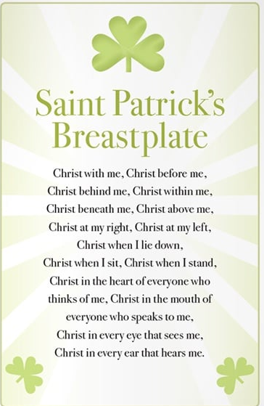
Whole-School Ideas
Celtic Prayer Walk
Create a walking trail around the school with stations featuring:
Lines from St Patrick’s Breastplate
Symbols from the new icon
Scripture passages about mission and courage
Students walk the trail as a reflective pilgrimage.

Slide 15
Feast Day Celebration (17 March)
Begin with a liturgy honouring St Patrick.
Include Celtic music, student-led prayers, and a blessing for RE leaders and teachers.
Display student artwork inspired by the icon.

Slide 16
Music Resources:
‘These Hands’ by Dave Gunning Video: https://youtu.be/wX_0lhXWutU
‘St Theresa’s Prayer’ by John Michael Talbot Video with lyrics: https://youtu.be/2SQtXzjC2pg
‘Go Light Your World’ by Chris Rice Video with lyrics: https://youtu.be/qcIo3KhnTTc
‘Servant Song’ by Bobby Fisher Video: https://www.youtube.com/watch?v=UgxfsqyrT2o
“The Light Of My Life” by Michael Mangan: https://www.youtube.com/watch?v=cLT9Fvbylvk

Slide 17
Vatican Links:
Lumen Gentium – The Universal Call to Holiness Chapter 5
Gaudete Et Exultate- Pope Francis’ Call to Holiness
Catechism of the Catholic Church 1716- 1729 Vocation to holiness (beatitude)

Slide 18
Additional Learning Experiences
Use KWL ‘Saints’, to introduce the children to those people venerated by the Church and whose lives reflect God’s goodness. Read through the pages together and allow for discussion.
Tell your child about your favourite saint: Your local library or www.catholic.org/saints/ website may be helpful. Illustrate the saint and write some interesting facts about him or her.
Explain to the children that the saints could be regarded as ‘The Stars of the Church’ because we look up to them as role models. Create a class display of the night sky with stars. Invite the children to find the name of a saint and to write the name in a star.
Focus on the life of St Patrick. Use the story of St Patrick in KWL. Teacher reads story. Allow time for the children to re-read the story on their own. Use the wondering statements in KWL to further engage children with the story of St Patrick.
Using story in KWL recall key episodes in St Patrick’s life. Children choose episodes to illustrate and/or write about.

Slide 19
Additional Learning Experiences
In groups, children create a frieze frame drama about the life of St Patrick based on the episodes illustrated in the previous activity. Share each drama with the class.
Pray St Patrick’s Breastplate prayer with actions
Sing a song related to St Patrick or St Patrick’s Breastplate, eg ‘The Light Of My Life’ by Michael Mangan, ‘The Deer’s Cry’ by Shaun Davey.
Share stories of the lives of different saints. Collect a range of books (appropriate reading level) about the saints that children can read during quiet reading time. This will enable children to become more familiar with different saints.

Slide 20
Additional Learning Experiences
If possible, visit St Patrick’s Cathedral, or other St. Patrick Parishes - plan a day with other sister schools, and locate and identify any statues or pictures of saint Patrick.
Use this as an opportunity to explore the story of the patron saint of the school. Identify the special qualities and characteristics that show how this person reflected the goodness of God. Complete a joint construction of an information report for this saint. This can provide the modelling for the children to follow when they write their own research report in a later activity.
Create a class wall story or story map outlining the life of the patron saint of the school. Invite the parish priest to visit the class to view the children’s work and share his information about the patron saint.

Slide 21
Additional Learning Experiences
Ask the children in the class if they have a saint’s name. Invite those children to discover more about that particular saint. This could be a research task. Those children without a saint’s name could be given a list from which to choose a saint to research. Teacher to provide simple points for research based on previous class joint construction e.g. name, birth date and place, feast day, patron of…, brief family background, something exciting or different that he/she did, how he/she tried to love others, as Jesus did. Locate suitable resources for the children to use (websites, books, videos).
See Christ in Others Scavenger Hunt: Find people doing good, loving actions around the school.
Shoe Design- Footsteps of Christ with St. Patrick use symbols and colours to reflect St. Patrick’s Charisms and values

