Slide 1
Religious Education Curriculum Update

Slide 2




Acknowledgement of Country
We acknowledge that MACS offices and Catholic schools in the Archdiocese of Melbourne are situated on the lands of the five language groups that make up the Kulin Nation, who have walked upon and cared for this land since time immemorial. We acknowledge their continued deep spiritual connection and relationship to Country.
We pay respects to their Elders past, present and future, and commit to the ongoing journey of truth-telling and deep listening, working together for reconciliation and justice.
Chelsea Sporle
St Anne’s School, Sunbury, Year 4

Slide 3
Prayer
Come, Holy Spirit! Be with us in our conversations today.
Open our hearts to your presence and open our ears in listening to each voice.
Help us to recognise how you are with your people, personally and when gathered in community.
Come, Holy Spirit, fill the hearts of your faithful, and kindle in them the fire of your love. Send forth your Spirit and they shall be created, and you will renew the face of the earth.
Bless all staff across the Archdiocese of Melbourne in our important work with students and families. May each person experience for themselves the light of your presence, and together may we give glory to your name.
We ask this through Christ our Lord, the teacher of all that is good. Amen.

Slide 4
Agenda
The context and model for Religious Education curriculum
The development cycle and governance of the curriculum
Introduction to the Religious Education Curriculum Writers at MACS
Feedback on work trialled in schools so far
An opportunity for Q&A

Slide 5
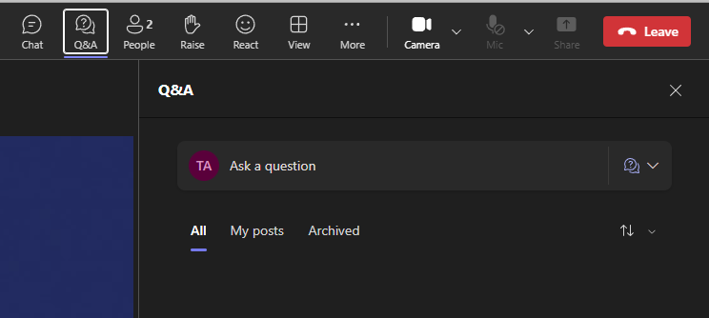
Questions and Answers
Q&A Panel in MS Teams

Slide 6
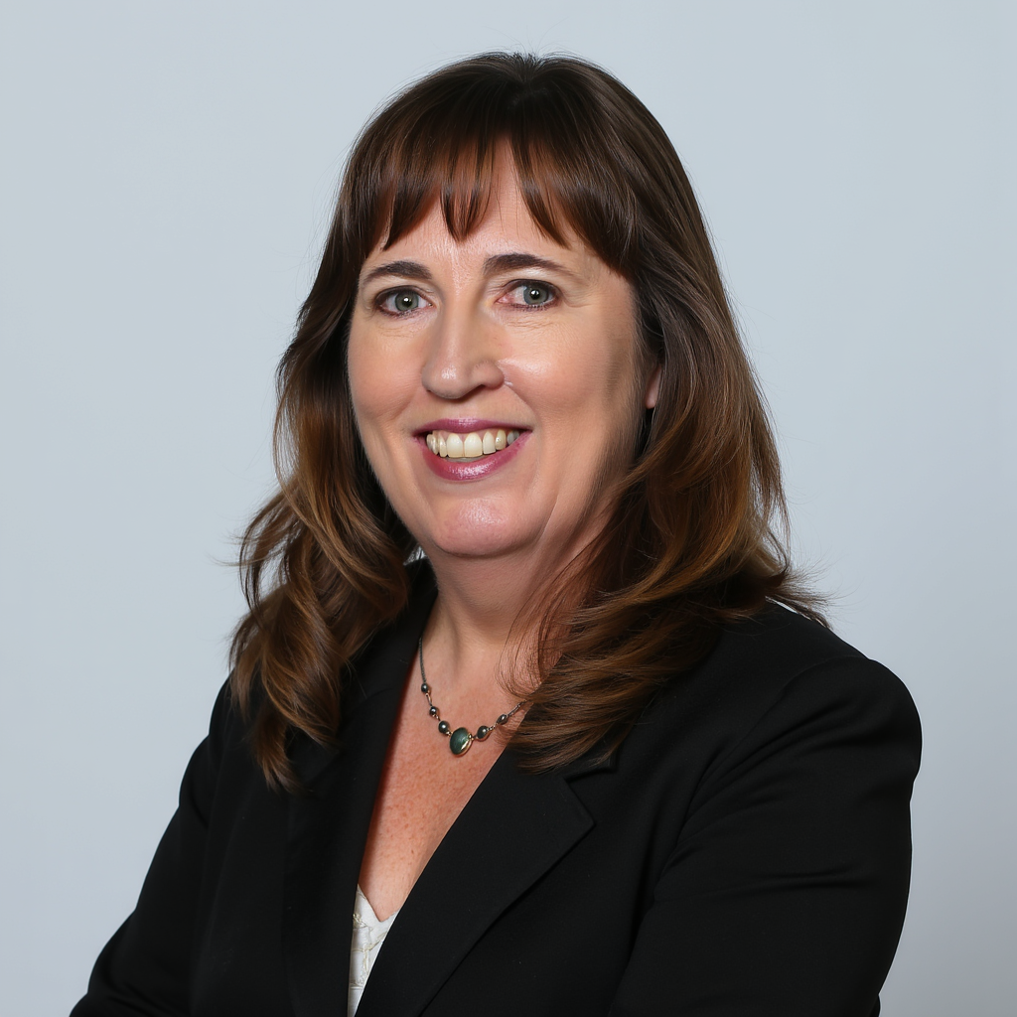
Manager, Religious Education Excellence Dr Beth Nolen

Slide 7
Context –Religious Education Reference Group
The Religious Education Reference Group oversees work being completed by the MACS RE Excellence Team in preparing a new RE Curriculum and have collaborated across ten monthly meetings since its first meeting in December 2024.
Reference Group members were appointed by Archbishop Peter A Comensoli.
Notes:
The Religious Education Reference Group has so far collaborated across ten monthly meetings since its first meeting in December 2024. Reference Group members were each appointed to their mandate by Archbishop Peter A Comensoli. The work of writing a new RE curriculum is conducted by the RE Excellence team on behalf of the archbishop with the vision that in time it be received as the RE Curriculum for all Catholic Schools in the Archdiocese of Melbourne. Members of the MACS RE Excellence Team attend the Reference Group

Slide 8

Context –Religious Education Reference Group
Membership:
Prof Br David Hall FMS (Chair)
Clergy (3)
Principals/Assistant Principals (9, incl. 1 religious)
Academics (3)
RE Leaders (2)
MACS Staff (3)
https://resource-macs.com/religious-education-reference-group/
Notes:
Members;
Prof Br David Hall fms (Chair) – Dean La Salle Academy, Australian Catholic University
Clergy:
Very Rev Mark Reynolds EV – Episcopal Vicar for Catholic Schools
Very Rev Dr Kevin Lenehan – Master, Senior Lecturer in Systematic Theology, Catholic Theological College
Rev Justin Ford – Parish Priest, Mentone and Parkdale East, Ricketts Point Nazareth
Principals:
Sr Mary Sarah Galbraith OP – Principal, St Bernard’s Parish Primary School
Mr Christoper Dalton – Principal, Sacred Heart Girls’ College, Hughesdale
Dr Darren Egberts - Principal, Sacred Heart College, Kyneton
Ms Janina Starkey – Assistant Principal, System, Learning & Metrics, St John Paull II Catholic college, Schofields Dr Janine Biggin – Principal, Emmanuel College, Altona North & Point Cook
Ms Anne O’Loughlin – Principal, Our Lady of Sacred Heart, Bentleigh
Ms Joanne Bacash – Principal, Antonine College, Coburg
Ms Mary Jones – Principal, St Francis Xavier, Box Hill
Ms Rosalba Squarci – Principal, St Raphael’s Catholic Primary, West Preston
Academics
Associate Prof Christine Robinson – Associate Dean (Research), Faculty of Education, University of Notre Dame Australia (WA)
Prof Richard Rymarz – Professor of Catholic Education, University of Notre Dame Australia
Associate Prof Dr Joel Hodge – National Head, School of Theology, Australian Catholic University
RE Leaders
Ms Vanessa Shaw – Learning Area Leader RE and Formation, Catholic Regional College, Caroline Springs
Dr Mishel Stefanac – Head of Religious Education, Middle Years, Xavier College
MACS
Ms Shauna-Maree Sykes – Chief, Education Strategy and Performance, Melbourne Archdiocese Catholic Schools
Dr Nigel Zimmermann – Director, Catholic Identity and Mission
Prof Kath Engebretson – Lead Curriculum Writer

Slide 9
Context –Religious Education Reference Group
The Reference Group have been active in taking up their role to oversee: the development of a new RE curriculum with a pedagogy grounded in evidence-based teaching and learning, and the encouragement of a sensory based approach in years F-2
RE Curriculum
Pedagogy
Support for Sensory Based Approaches (F-2)
Notes:
The Religious Education Reference Group oversees work being completed by the MACS RE Excellence Team in preparing a new RE Curriculum. The Reference Group have been active in taking up their role to oversee: the development of a new RE curriculum with a pedagogy grounded in evidence-based teaching and learning, and the encouragement of a sensory based approach in years F-2 [components named in the Reference Group Terms of Reference and affirmed by the RE Curriculum Report (2023)]. We see our work as part of a broader journey of walking together across all Melbourne’s Catholic schools to enable and encourage excellence in every RE classroom.
The Religious Education Reference Group ensures that the approach taken in the development of curriculum and pedagogy is: Christ-centred, mission-focused, pedagogically sound, developmentally appropriate, content-rich, and shaped for the needs of today’s students. Along with work on relevant and adjacent matters, in the second hour of each Reference Group meeting members provide feedback on whole units of work written in the month prior by the RE Excellence Team. The writers follow a regular rhythm of collaboration punctuated by these Reference Group meetings. The writers then make edits and adjustments to units according to feedback from both the Reference Group and the Trial-Based Learning Teams.

Slide 10
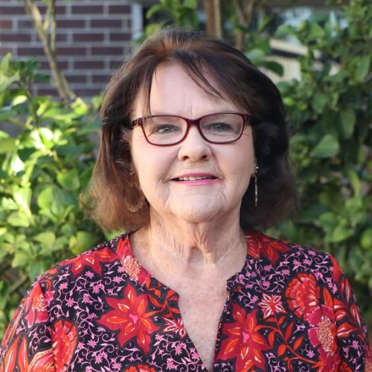

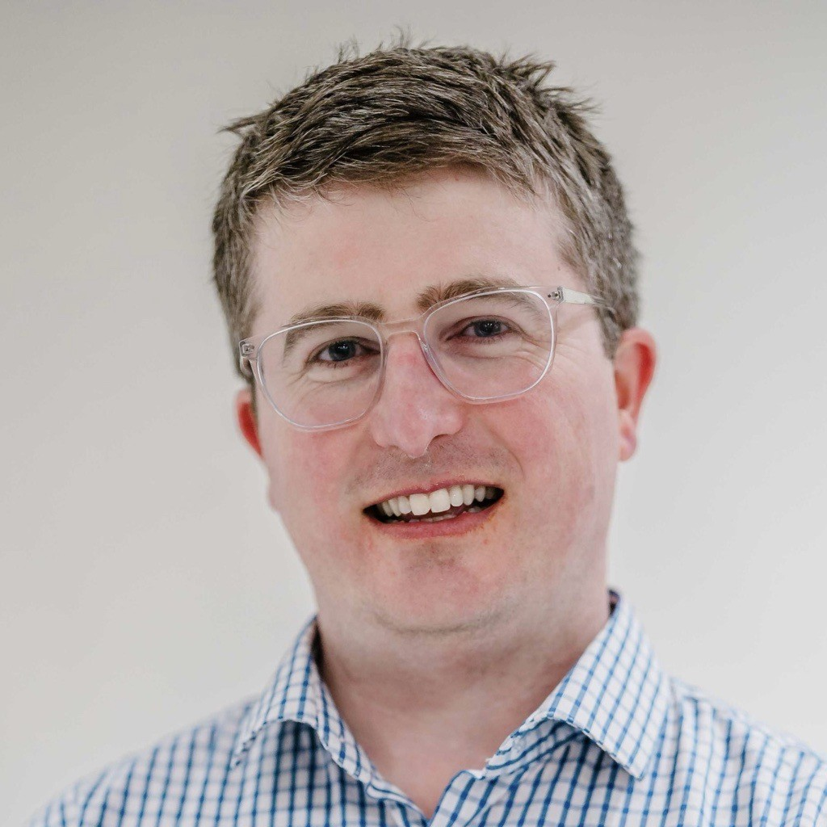
RE Curriculum Writers
Prof Kath Engebretson Lead Curriculum Writer
Marsha Van Cuylenburg Curriculum Writer (Primary)
James O’Brien Curriculum Writer (Secondary)

Slide 11
Curriculum Model
Curriculum Coherence
Knowledge rich.
Knowledge is sequenced and mapped
Ambitious in knowledge
Emphasis on learning progressions
Sequential development of content and skills
There is horizontal alignment across a year level and vertical alignment from year level to year level.
Formative and summative assessments reflect cognitive outcomes
Notes:
Knowledge rich.
Knowledge is sequenced and mapped deliberately and coherently.
Teachers are ambitious for students in the knowledge they select
There is an emphasis on learning progressions (sequenced learning) and clearly defined learning outcomes
Content and skills build sequentially
There is vertical alignment across a year level and horizontal alignment from year level to year level.
Formative and summative assessments reflect cognitive outcomes

Slide 12
Chronological: across year levels and from year level to year level
Kerygmatic: The story of the salvific and eschatological significance of Jesus Christ is proposed to students as meeting the deep questions of their lives
Cumulative: Knowledge draws on what has gone before. Cumulative within a year level and from year level to year level
Coherent Curriculum: Every piece is part of the whole
Thematic: There is a theme across each year level to which every unit contributes
Christocentric: every unit elucidates in some way the story of Jesus Christ
Sequential: The units are in a logical and chronological sequence across the year level

Slide 13
Development Cycle
The entire curriculum is composed of fully developed units of work, up to 10 at each year level.
There are already 35 units developed in total
Units have been developed at Foundation, Year 1, Year 6, Year 7, Year 8, and Year 10.
Notes:
Units of work written on the assumption that there is significant classroom religious education instructional hours per week
The units of work are written with as much guidance as possible for teachers who need the most support, and with flexibility where appropriate for expert teachers to adapt as needed.
35 developed units include units that have been drafted, or been to the reference group, or trialled in schools etc

Slide 14
Development Cycle
Curriculum writers are developing units of work following a set structure
Drafts are shared among the team for feedback
Updated drafts are submitted to the reference group for review
Writers receive feedback on work from the reference group and adopt or reply to the feedback
Units of work are trialled in schools via principal’s circular expressions of interest
Feedback from trials is considered by curriculum writers

Slide 15
Foundation
Unifying Theme
To know you the one true God and Jesus Christ whom you have sent (John 17:3)
Units of Work
1 Jesus Shows Us God’s Love
2 Lent
3 Holy Week and Easter
4 God and Me (prayer)
5 The Holy Spirit: God’s Gift to Us
6 All Are Invited: God’s Family and the Church
7 Advent: A Time to Prepare for Jesus
8 Christmas: God is With Us
Year 8
Unifying Theme
A new Covenant in Christ invites all into relationship with God
Units of Work
1 Good News for the World: Jesus in the Gospels
2 Jesus in His Time
3 Jesus and Prayer
4 Jesus the Teacher
5 Jesus Calls Disciples to Join His Mission
6 The Miracles of Jesus
7 Jesus’ Passion and Death, Resurrection, and Ascension
8 The Incarnation of Jesus Christ
9 The early Church and St Paul
Notes:
Primary School:
Units of work follow as closely as possible the liturgical year.
Each year, ideas unfold and develop on each other.
Lent in Foundation to Year 6 develops each year, beginning with basic ideas of Lent, up to Year 6 looking at giving to Caritas etc for human development
Focus on the sacraments in Year 3; beginning the cycle of sacramental introduction
Developmentally appropriate teaching strategies, including sensory based approaches, such as scriptural storytelling with figures, specifically taught prayers of the Church, etc.
Secondary School
Developing story of salvation history
Year 7 and the unfolding covenant fulfilled in Jesus Christ
Year 8 developing understanding of Jesus Christ and the beginning of the Church
Year 9 and sacraments as helping us fulfil a life in Christ
Year 10 and the moral life that follows belief in Christ

Slide 16
School Trials
Term 3 School Trials – by expression of interest
26 Schools
16 Primary
Four foundation units
10 Secondary
Two secondary units
Term 4 School Trials – by expression of interest
20 Schools:
14 Primary
Three foundation units
6 Secondary
Five secondary units
Notes:
Feedback:
Positives:
Very happy with the detail provided in the units of work
Teacher preparation content provided for reading, clear content for learning, reference to modern pedagogy and explicit instruction
Room in curriculum for catechesis, evangelisation, exploration and inquiry
High expectations of learning for students
Challenges:
Time available in schools to teach RE
Size of the units and time needed to teach well
Lack of prior knowledge, starting from the middle of a curriculum
Pedagogy of RE -> still to be clearly defined

Slide 17
Feedback From Trial Teams
Positives
Teacher background material and critical content for learning is detailed
Emphasis on scripture in units of work and using a physical Bible
Flexibility to adopt appropriate teaching and assessing strategies to suit the school context
Sensory based approaches to teaching in F-2
Challenges
Time allocation in schools and the content in the curriculum
Reporting scenario is not currently clear
Resource development and teacher professional learning still in progress
Notes:
This represents some of the feedback from teachers who completed trials in units of work.
Possibility to have a teacher from the ‘audience’ who did complete the trial unmute and give their perspective??
Feedback:
Positives:
Very happy with the detail provided in the units of work
Teacher preparation content provided for reading, clear content for learning, reference to modern pedagogy and explicit instruction
Room in curriculum for catechesis, evangelisation, exploration and inquiry
High expectations of learning for students
Challenges:
Time available in schools to teach RE
Size of the units and time needed to teach well
Lack of prior knowledge, starting from the middle of a curriculum
Pedagogy of RE -> still to be clearly defined

Slide 18
Some Learnings from Term 3 Trialling
Schools who continued to connect with their team were able to problem-solve some challenges together and identify some rich insights
The feedback process would benefit by having someone who can lead the professional conversations and probe further to explore the 'why'
Feedback only at the end of teaching the unit did not enable timely support interventions
There are some excellent teaching strategies happening within schools – we need to find ways to identify and amplify these strategies

Slide 19
2026 School Trials
Currently completed drafts curriculum:
Foundation (Prep)
Year 7
Year 8
Expression of Interest for trials in 2026 will be opened to principals in the October 17 school principal circular and school bulletin.
Trial-based Learning Teams will include schools trialling the full year of curriculum, and schools with part year trials.

Slide 20
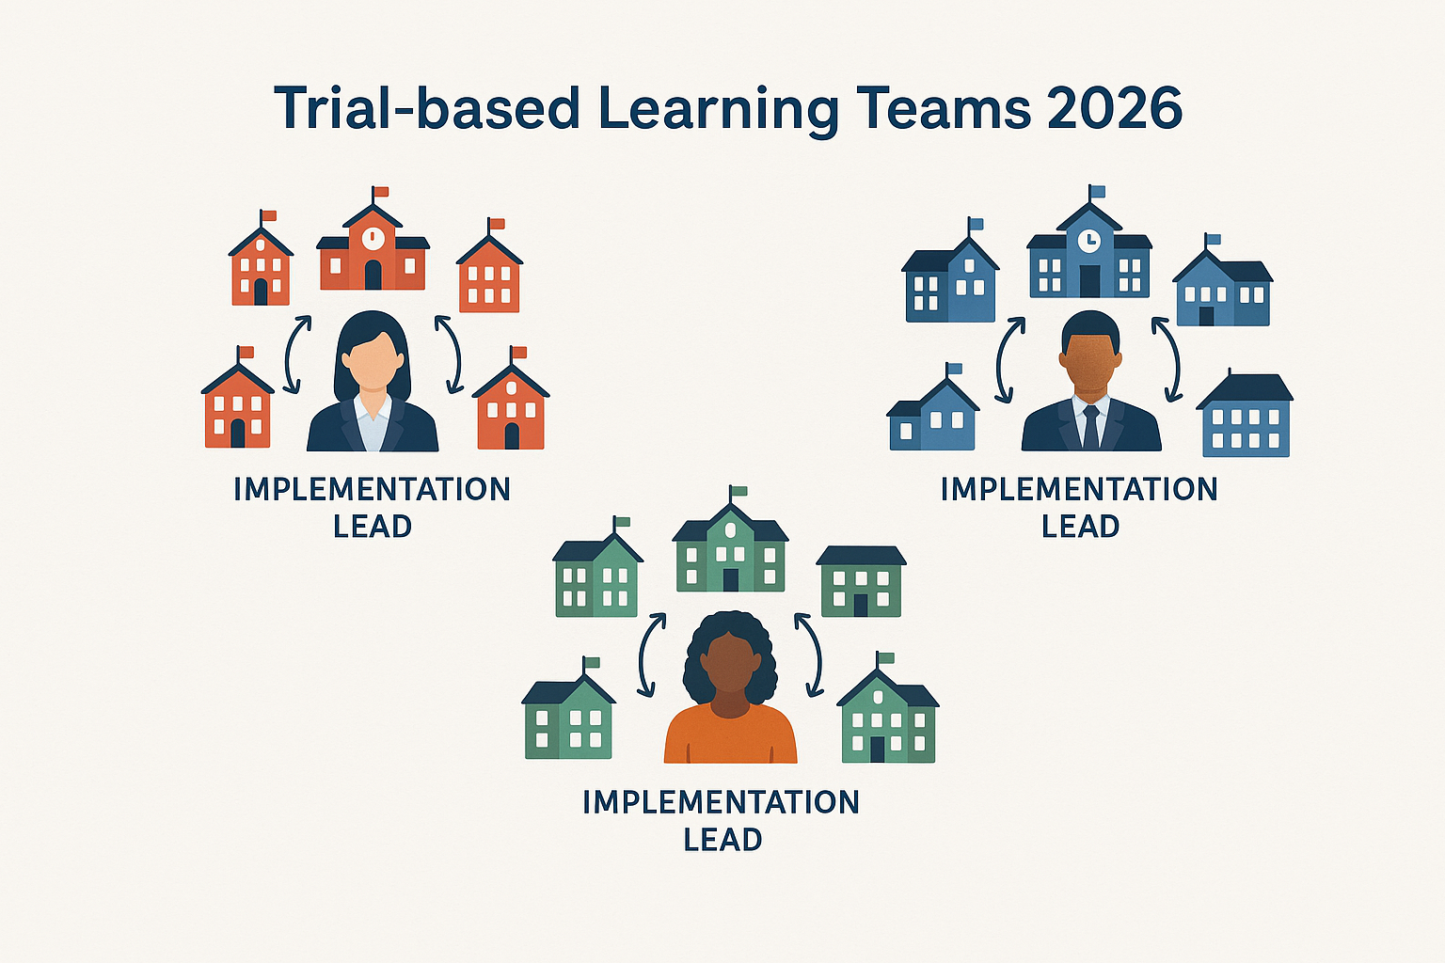
The purpose of the 2026 model
Monitor – Interventions when needed
Build skills – Capacity building for teachers and RELs
Identify – Practices that lead to RE excellence
Address – Anything that is blocking RE excellence
Grow – Shared understanding across all Archdiocesan schools
Embed – Professional learning
Implementation Leads feedback to the RE Excellence Team

Slide 21
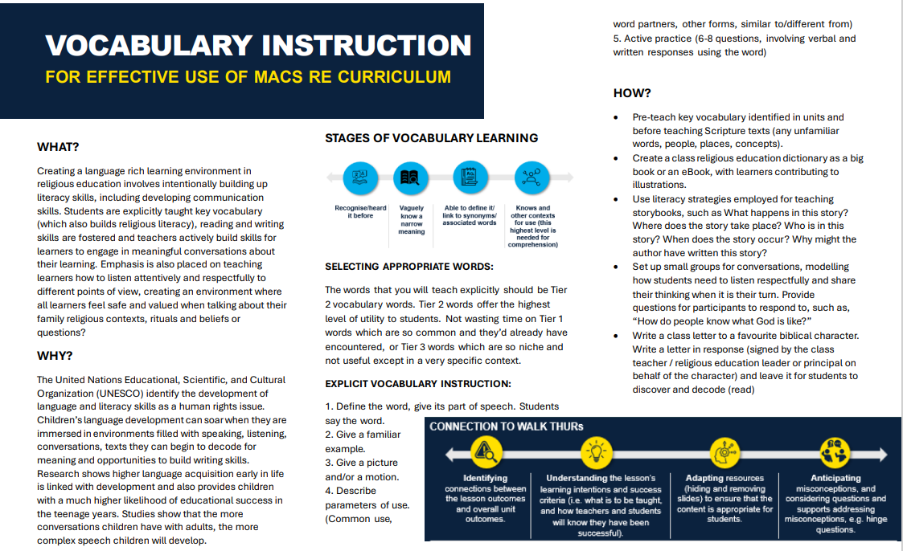
Draft One!

Slide 22
An example of responding to identified needs:
Silent Prayer Practices - Pilot Project for Melbourne Catholic Schools
1. Introduction and Welcome Video
2. Brain Basics: Everyone is Unique! (+ Video)
3. Neurotypical and Neurodivergent Brains
4. How Silent Prayer Nourishes our Brains and Bodies (+ Video)
5. Movements Before and During Silent Prayer (+ Video)
6. Prayer Practices (10+) with Instructions (+ Video)
7. Journal Prompts (+ Video)
8. Teacher Evaluation Questions 9. Resources (Articles, websites and videos)

Slide 23
Implementation
Developing curriculum in 2025 and 2026
Fully developed units of work
Seeking feedback from key stakeholders
CAM clergy and religious, schools, teachers, tertiary institutions
Implementing Curriculum
Accompanied with classroom resources
Teacher professional learning
A whole school approach to faith development
Notes:
When will the curriculum be finished?
At this stage, drafting is continuing – with the planned units being one-third drafted , reviewed, or trialled in some form.
Our intention is for trialling to continue next year in schools – with a 2027 aim for ecclesial approval with the Archbishop of Melbourne
Professional Learning platform will exist with materials for teacher formation, development, TAP accreditation hours, a mix of in-person, online, hybrid, and self-paced courses (New PL Platform)

Slide 24
2026 Curriculum Trials
Principal’s Circular, October 17
Foundation, Year 7, Year 8
Whole year of curriculum
MACS and RI/MPJP Schools
Expression of Interest included with Principal’s Circular
FAQs published on RESource, October 17
Implementation Lead

Slide 25

Implementation Feedback
https://forms.office.com/r/NA2twyi51i

Slide 26
Questions and Answers

Slide 27
Thank you very much!

