Slide 1
Classroom Daily Prayer
Fifteenth week of Ordinary time, 12 July 2020
Notes:
This is the tenth weekly resource in the daily prayer series.

Slide 2
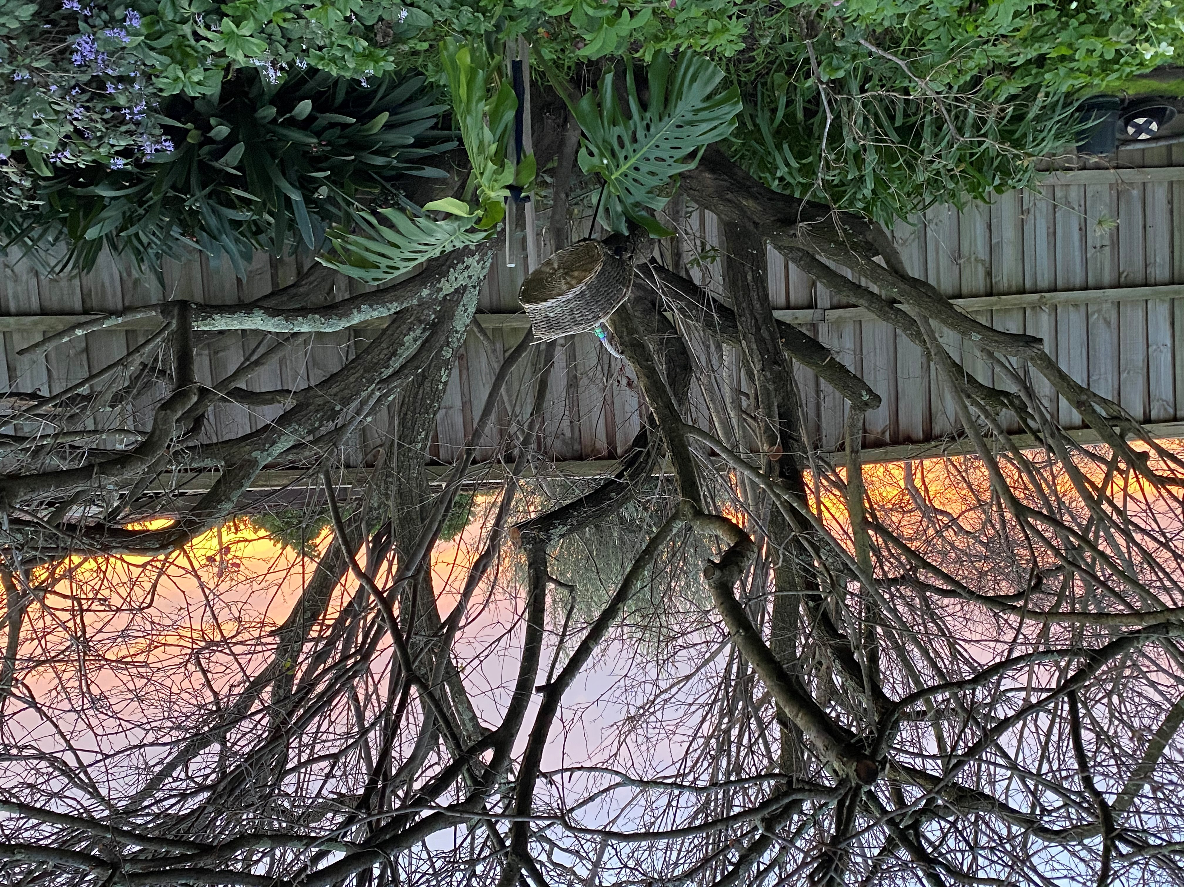
Gather
Good Morning.
Let us prepare for our morning prayer together …
Notes:
Let us start the day by coming together in prayer.
Let us set up the prayer table.
This week, the prayer space remains the colour green, as we have settled back into the liturgical season of Ordinary time.
We will use a green cloth and place objects on the table that remind us of God in our everyday lives, something from nature would be nice.
You may like to hold onto something in your hand – some rosary beads, a cross or a special object.
Place your object in your hand now.
Sit up straight, notice your breathing and focus on the picture on the screen, as we listen to some music that will help us focus our minds and open our hearts to God.

Slide 3
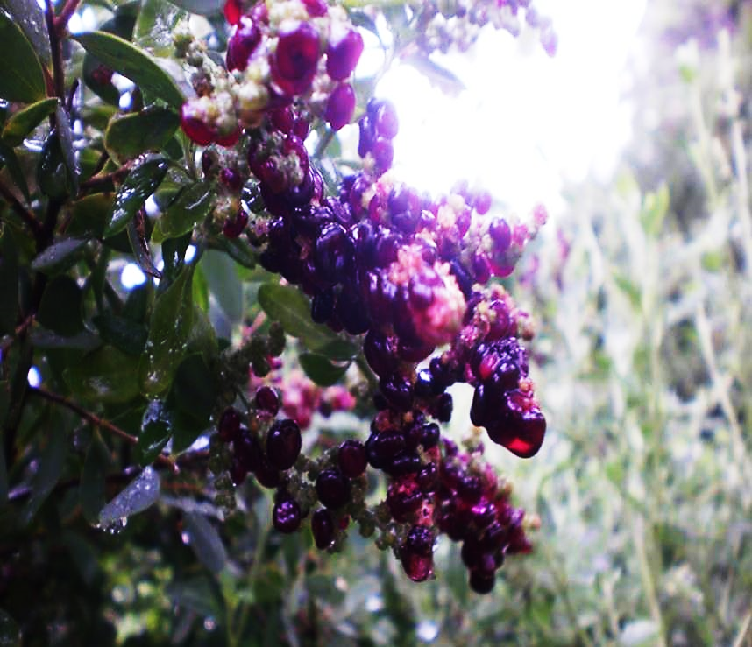
Notes:
As you sit, look into this picture. What do you see? What are you focusing on? The purple berries hanging from the tree branches? The green leaves? The light peeking through the background? The raindrops sitting on the gently on the leaves?
Focus on your breathing and enter into the picture before you.

Slide 4
Notes:
Listen to the music and settle yourself into the picture and into your breathing.

Slide 5
Notes:
I now invite you to open up your heart and enter into a deeper part of yourselves, the part where we can sit and be still with God. (Pause)
In the name of the Father, Son and Holy Spirit. Amen.

Slide 6
Listen
The Lord's word is life giving
Is 55:10- 11
Notes:
MONDAY
A reading from the prophet Isaiah.
Thus says the Lord:
‘As the rain and the snow come down from the heavens and do not return without watering the earth, making it yield and giving growth to provide seed for the sower and bread for the eating, so the word that goes from my mouth does not return to me empty, without carrying out my will and succeeding in what it was sent to do.’
The word of the Lord.

Slide 7
Respond
Notes:
MONDAY
This reading from the old testament sets the theme for the week….
We are going to be focusing on how God communicates His love for us, and if we are ready to receive these messages of love we will live our best lives and grow and blossom like the trees and plants of a well cared for garden.
What images were described to you in this reading, what did you hear?
(rain, snow watering the earth seeds growing, bread being made, ready to eat)
What do you think of when you hear these words, what comes to mind?
(the earth being watered and refreshed, the seasons, the crops and harvest, the food cycle of nature, being provided for, being nourished and fed, abundance, life and creation)
In the ancient world when this text was written, the people lived their lives closely connected to nature, they were very aware of the changing seasons and the natural world around them. Therefore many of the scriptures describe God’s ways in terms of nature to help the audience to understand and get to know God more fully.
Let’s do it now….
Have you ever felt the great refreshing feeling from water, like when you dive into the ocean or river or if you are caught in the rain? Do you know that feeling? Its kind of exhilarating, it makes you feel really awake and alive.
Or have you ever been to the snow? Maybe you did these holidays? You are feeling snug in your ski gear but you can feel the icy wind on your face or you get a snowball thrown at you and the iciness on your skin send shivers of delight through your body. Maybe you have felt the warmth of the sun on your back or shoulders? Perhaps you have sat in front of a roaring log fire and have smelt the smoke and heard the crackling as you have warmed your feet and wriggled your toes in cosy comfort.
Let’s sit here for a few moments and remember times when we have enjoyed being in nature, when we have really sensed the wonder of creation, visit those memories and feelings now.

Slide 8
Respond
Lord Jesus
Help us to receive your
goodness
Notes:
MONDAY
Let's bring all these memories to our prayer today and thank God for sending us these messages of love through the wonder of creation.
(Pick up on what the students have said and some further examples below if needed.)
We ask this and all the prayers that lie within our hearts (Ask the students to contribute.)
We pray for the leaders of the world; help them make wise decisions to protect and care for all people
We pray for each other – that we can continue to learn and grow
We pray for our teachers
We pray for our families
We pray for those who care for the environment
We pray for all those who are sick and those who have died
We thank God for the good times we have experienced on our holidays
We ask God to look after us as we begin a new term
We pray for those people who are struggling or under stress, because they have lost their jobs

Slide 9
Go Forth
Let us embrace the chance to flourish and grow
Amen.
Notes:
Our final blessing …
In the name of the Father, the Son and the Holy Spirit … (finish with the sign of the cross).

Slide 10
Listen
Jesus says
“Listen, anyone who has ears”
Mt 13: 1- 9
Notes:
TUESDAY
A reading from the holy Gospel according to Matthew.
Jesus in our thoughts, Jesus in our words, Jesus in our hearts. Cross your forehead, lips and heart.
Jesus left the house and sat by the lakeside, but such crowds gathered round him that he got into a boat and sat there. The people all stood on the beach, and he told them many things in parables.
He said, ‘Imagine a sower going out to sow’. As he sowed, some seeds fell on the edge of the path, and the birds came and ate them up..

Slide 11
Respond
Notes:
TUESDAY
For the rest of the week we will reflect on the gospel of Matthew where Jesus tells his followers the Parable of the Sower.
Remember last term we read a couple of parables, who remembers what they are? (A parable is a story with a moral or a lesson and, at its heart, is teaching the listener about how to live or how to behave.)
We are going to be hearing a few parables over the next weeks, as Jesus liked to use this way of story telling to explain to his followers the way to live. He knew there were many levels to the stories he told and each person listening could take the message they needed to hear.
The Parable of the Sower is about the farmer who is planting his crop. In Jesus’ time it was common practice for the farmers to scatter the seeds along the ground. Rather than making a furrow and planting seeds deliberately in the ground, then covering them with soil, the farmer would walk along with a sack of seeds, take a handful and simply cast the seeds around. In this manner some would fall where the breeze took them: among rocks, into weeds, on a path and some would fall on good soil.
Jesus is using a common practice known to his audience but telling them a story and asking them to think about it in a different way.
What do you think Jesus is talking about in this parable?
Who is the sower? (Jesus and following on from Him his disciples)
What/who is the seed? (the word of God, the teaching of Jesus, the messages from God)
What are the circumstances of the seeds? (all the things that get in the way that stop us from hearing and acting upon the messages from God)
Today the seeds fall on the edge of the path and are eaten up by the birds what does that mean for you? Jesus’ message of love had no time to be even heard. What stops us from hearing Jesus’ message?

Slide 12
Respond
Lord Jesus
Help us to receive your goodness
Notes:
TUESDAY
Let’s talk to Jesus now, asking for the help we need to hear His messages of Love.
Let’s bring all those thoughts and feelings, even if we don’t say them out loud, to our prayers now as we pray together.
We pray for the leaders of the world; help them make wise decisions to protect and care for all people
We pray for each other – that we can continue to learn and grow
We pray for our teachers
We pray for our families
We pray for those who care for the environment
We thank God for the good times we have experienced on our holidays
We ask God to look after us as we begin a new term
We pray for all those who are sick and those who have died
We thank God for our safe return to school
We pray for those people who are struggling or under stress, because they have lost their jobs
We thank God for the good times we have experienced by being at home …

Slide 13
Listen
Jesus says
Listen, anyone who has ears”
Mt 13: 1–9
Notes:
WEDNESDAY
A reading from the holy Gospel according to Matthew.
Jesus in our thoughts, Jesus in our words, Jesus in our hearts. Cross your forehead, lips and heart.
Others fell on patches of rock where they found little soil and sprang up straight away, because there was no depth of earth; but as soon as the sun came up they were scorched and, not having any roots, they withered away.

Slide 14
Respond
Notes:
WEDNESDAY
What happened to the seeds today?
Where have they fallen? (on the rock)
What helped their growth? (soil)
What hindered their growth? (not enough soil, scorched by the sun)
What do the seeds represent? (messages of God’s love)
Thinking of your own life, what do you think helps you hear God’s messages of love, what helps you grow, what is your soil?
Sit quietly and see what comes to mind…….gently invite a response and sharing.

Slide 15
Respond
Lord Jesus
Help us to receive your goodness
Notes:
WEDNESDAY
Let’s bring all those thoughts and feelings, even if we don’t say them out loud, to our prayers now as we pray together.
Lord Jesus, thank you for all those in our lives who show us your goodness and love and help us to grow…
(Pick up on what the students have said and some further examples below if needed.)
We pray for the leaders of the world; help them make wise decisions to protect and care for all people
We pray for each other – that we can continue to learn and grow
We pray for our teachers
We pray for our families
We pray for those who care for the environment
We thank God for the good times we have experienced on our holidays
We ask God to look after us as we begin a new term
We pray for all those who are sick and those who have died
We thank God for our safe return to school
We pray for those people who are struggling or under stress, because they have lost their jobs
We thank God for the good times we have experienced by being at home …

Slide 16
Listen
Jesus says
“Listen, anyone who has ears”
Mt 13: 1–9
Notes:
THURSDAY
A reading from the holy Gospel according to Matthew.
Others fell among thorns, and the thorns grew up and choked them.

Slide 17
Respond
Notes:
THURSDAY
What do you think is happening today with the seeds?
And thinking of the seeds as messages of love from God, what’s going on today in the reading?
Who or what are the thorns that are present in our lives and how do they choke us and stop us from growing?
Plenty of food for thought today and lots of scope for interesting conversation with your students, topics that could be raised include: (choose wisely and discuss sensitively)
being selfish, greedy, mean, gossiping, not sharing or being generous, not being truthful or fair, cheating, being negative, too much screen time, listening to negative influences, laziness, going through rough times, suffering, loneliness, self doubt, anxiety, depression

Slide 18
Respond
Lord Jesus
Help us to receive your goodness
Notes:
THURSDAY
Let’s bring all those thoughts and feelings, even if we don’t say them out loud, to our prayers now as we pray together.
Help us Jesus to be the best we can be, help us to keep trying even when we make mistakes.
(Pick up on what the students have said and some further examples below if needed.)
We pray for the leaders of the world; help them make wise decisions to protect and care for all people
We pray for each other – that we can continue to learn and grow
We pray for our teachers
We pray for our families
We pray for those who care for the environment
We thank God for the good times we have experienced on our holidays
We ask God to look after us as we begin a new term
We pray for all those who are sick and those who have died
We pray for those people who are struggling or under stress, because they have lost their jobs
We thank God for our safe return to school
We thank God for the good times we have experienced by being at home …

Slide 19
Listen
Jesus says
“Listen, anyone who has ears”
Mt 13: 1–9
Notes:
FRIDAY
A reading from the holy Gospel according to Matthew.
Jesus in our thoughts, Jesus in our words, Jesus in our hearts. Cross your forehead, lips and heart.
Others fell on rich soil and produced their crop, some a hundredfold, some sixty, some thirty.
Listen, anyone who has ears!’

Slide 20
Respond
Notes:
FRIDAY
What happened to the seeds today?
Emphasise the yield of the crop and that the end result more than makes up for the loss of the other seeds.
Same with the analogy…when the messages of love are received from God in a person’s heart they take hold and multiply and the result is magnified
so the word that goes from my mouth does not return to me empty, without carrying out my will and succeeding in what it was sent to do.’ (from the reading on Monday)
The hope of God is that the soil of our hearts is rich and fertile so we are ready to receive the messages of love that are all around us and are being constantly sent to us each and every day. As Jesus says today
‘Listen, anyone who has ears!’
Where do you hear these messages of love? Who/what are your messengers?
Sit quietly with this for a moment.
Perhaps conclude together by singing Open my eyes Lord #582 Catholic Worship Book People’s Edition
(rather than the next slide: prayers of intercession).

Slide 21
Respond
Lord Jesus
Help us to receive your goodness
Notes:
FRIDAY
Jesus, thank you for all the people and opportunities in our lives that provide us with rich soil for growth and flourishing
We pray for the leaders of the world; help them make wise decisions to protect and care for all people
We pray for each other – that we can continue to learn and grow
We pray for our teachers
We pray for our families
We pray for those who care for the environment
We thank God for the good times we have experienced on our holidays
We ask God to look after us as we begin a new term
We pray for all those who are sick and those who have died
We pray for those people who are struggling or under stress, because they have lost their jobs
We thank God for our safe return to school
We thank God for the good times we have experienced by being at home …

Slide 22
Acknowledgements
Photograph: ‘Abundance’ photograph by Lisa Hughes used with permission
Music: Waterfall, royalty-free music: https://www.youtub.com/audiolibrary
Scripture: accessed from Liturgy Help: https://liturgyhelp.com/calendar/date/2020Jul12/0
The Emmaus Series: http://www.theemmausseries.com/
Catholic Worship Book People’s Edition 2016 Morning Star Australia
PowerPoint presentation created by Lisa Hughes, Formation Officer, Catholic Leadership and Governance, CEM. Contact: lhughes@cem.edu.au / (03) 9267 0228

